Slide 1
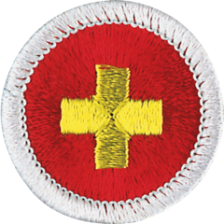
First Aid Merit Badge
Troop 344 and 9344
Pemberville, OH

Slide 2
First Aid Merit Badge Requirements
Demonstrate to your counselor that you have current knowledge of all first-aid requirements for Tenderfoot, Second Class, and First Class ranks.
Explain how you would obtain emergency medical assistance from:
Your home.
A remote location on a wilderness camping trip.
Define the term triage. Explain the steps necessary to assess and handle a medical emergency until help arrives.
Explain the precautions you must take to reduce the risk of transmitting an infection between you and the victim while administering first aid.

Slide 3
First Aid Merit Badge Requirements
Do the following:
Prepare a first-aid kit for your home. Display and discuss its contents with your counselor.
With an adult leader. Inspect your troop's first-aid kit. Evaluate it for completeness. Report your findings to your counselor and Scout leader.
Describe the early signs and symptoms of each of the following and explain what actions you should take:
Shock
Heart attack
Stroke

Slide 4
First Aid Merit Badge Requirements
Do the following:
Describe the conditions that must exist before performing CPR on a person.
Demonstrate proper CPR technique using a training device approved by your counselor.
Explain the use of an automated external defibrillator (AED).
Demonstrate or simulate the proper use of an automated external defibrillator (AED), using an AED training device if available.
Identify the location of the AED at your school, place of worship, and troop meeting place, if one is present.

Slide 5
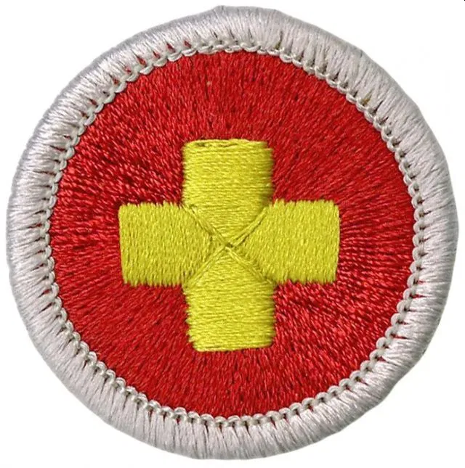
First Aid Merit Badge Requirements
Do the following:
Show the steps that need to be taken for someone who has a large open wound or cut that is not bleeding severely.
Show the steps that need to be taken for someone who has a large open wound or cut that is severely bleeding.
Explain when it is appropriate and not appropriate to use a tourniquet. List some of the benefits and dangers of the use of a tourniquet.
Demonstrate the application of a tourniquet without tightening it.
Explain when a bee sting could be life threatening and what action should be taken for prevention and for first aid.

Slide 6
First Aid Merit Badge Requirements
Describe the signs, symptoms, and potential complications of a fracture and dislocation.
Demonstrate the proper procedures for handling and immobilizing suspected closed or open fractures or dislocations of the:
Finger
Forearm
Wrist
Upper leg
Lower leg
Ankle
Describe the signs, symptoms, and possible complications and demonstrate care for someone with a suspected injury to the neck or back.

Slide 7
First Aid Merit Badge Requirements
Describe the symptoms, proper first-aid procedures, and possible prevention measures for the following conditions:
Concussion
Anaphylaxis/allergic reactions
Asthmatic attack
Bruises
Sprains or strains
Hypothermia
Frostbite
Burns - first, second, and third degree
Convulsions/seizures
Dehydration
Muscle cramps
Heat exhaustion
Heat stroke
Abdominal pain
Broken, chipped, or loosened tooth

Slide 8
First Aid Merit Badge Requirements
Do the following:
Describe the conditions under which an injured person should be moved.
If a sick or an injured person must be moved, tell how you would determine the best method. Demonstrate this method.
With helpers under your supervision, improvise a stretcher and move a presumably unconscious person.
Describe the following:
The indications that someone might be a danger to themselves or others.
What action you should take if you suspect that someone might be a danger to themselves or others.
Teach another Scout a first-aid skill selected by your counselor.

Slide 9
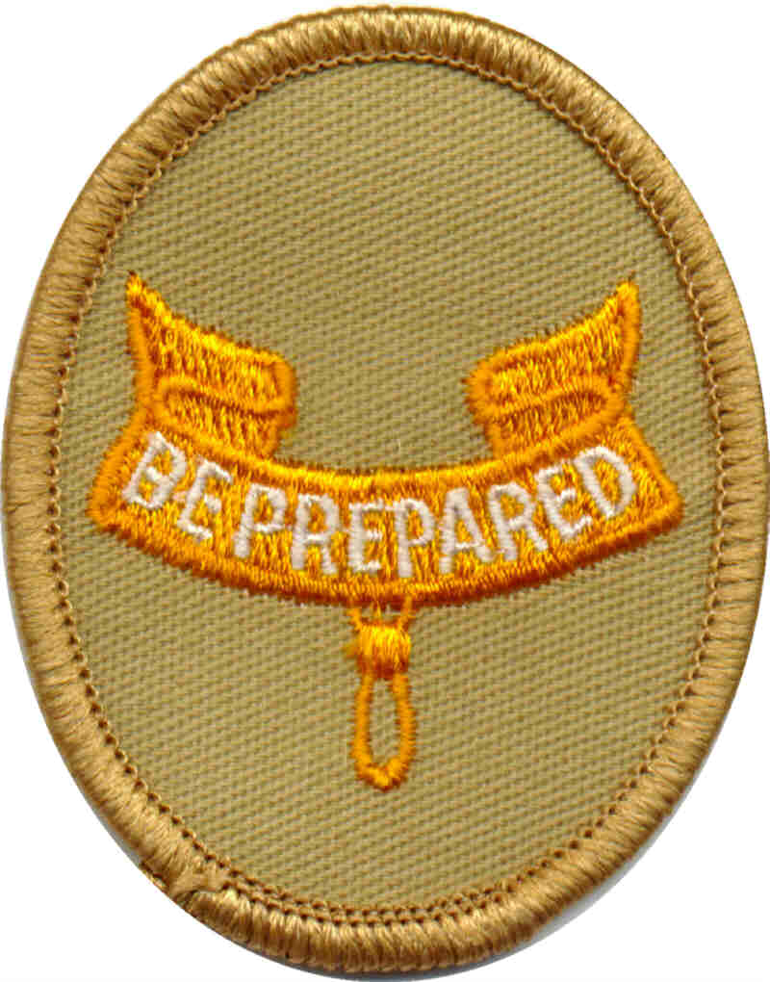
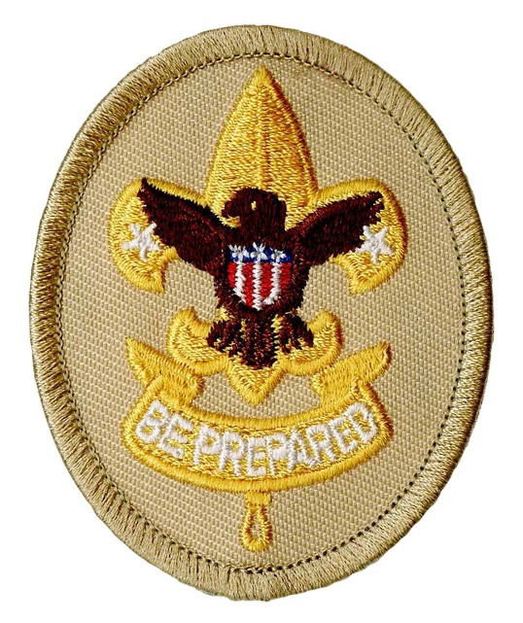
Requirement #1
Demonstrate to your counselor that you have current knowledge of all first-aid requirements for Tenderfoot, Second Class, and First Class ranks.

Slide 10
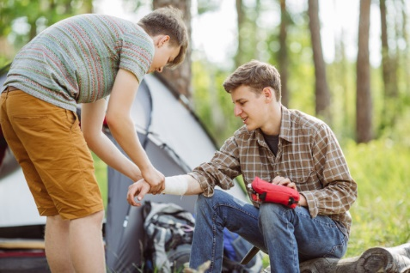
What is First Aid?
First aid is caring for injured or ill persons until they can receive professional medical care.
It is an important skill for every Scout.
With knowledge of first aid, a Scout can provide immediate care and help to someone who is hurt or becomes ill.
Notes:
Emphasize that scouts do real first aid and make a difference. Being a kid does not matter with regards to first aid.

Slide 11
Tenderfoot First Aid Requirements
Show first aid for the following:
Simple cuts and scrapes.
Blisters on the hand and foot.
Minor (thermal/heat) burns or scalds (superficial, or first degree)
Bites or stings of insects or ticks.
Venomous snakebite.
Nosebleed.
Frostbite and sunburn.
Choking.
Show what to do for hurry cases of stopped breathing, stroke, severe bleeding, and ingested poisoning.

Slide 12
2nd Class First Aid Requirements
Show first aid for the following:
Object in the eye
Bite of a warm-blooded animal
Puncture wounds from a splinter, nail, and fishhook
Serious burns (partial thickness, or second-degree)
Heat exhaustion
Shock
Heatstroke, dehydration, hypothermia, and hyperventilation

Slide 13
1st Class First Aid Requirements
Show first aid for the following:
Demonstrate bandages for a sprained ankle and for injuries on the head, the upper arm, and the collarbone.
By yourself and with a partner, show how to:
Transport a person from a smoke-filled room.
Transport for at least 25 yards a person with a sprained ankle.
Tell the five most common signals of a heart attack. Explain the steps (procedures) in cardiopulmonary resuscitation (CPR).

Slide 14
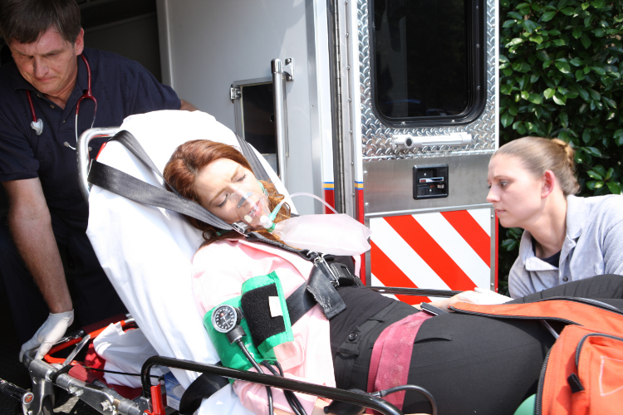
Requirement #2
Explain how you would obtain emergency medical assistance from:
Your home.
A remote location on a wilderness camping trip.

Slide 15
Obtaining Medical Assistance from Home
Call 911 immediately for a life threatening injury or illness.
Do not try to transport a critical victim to the emergency room yourself.
Ask a neighbor for help, or flag down a passing car.

Slide 16
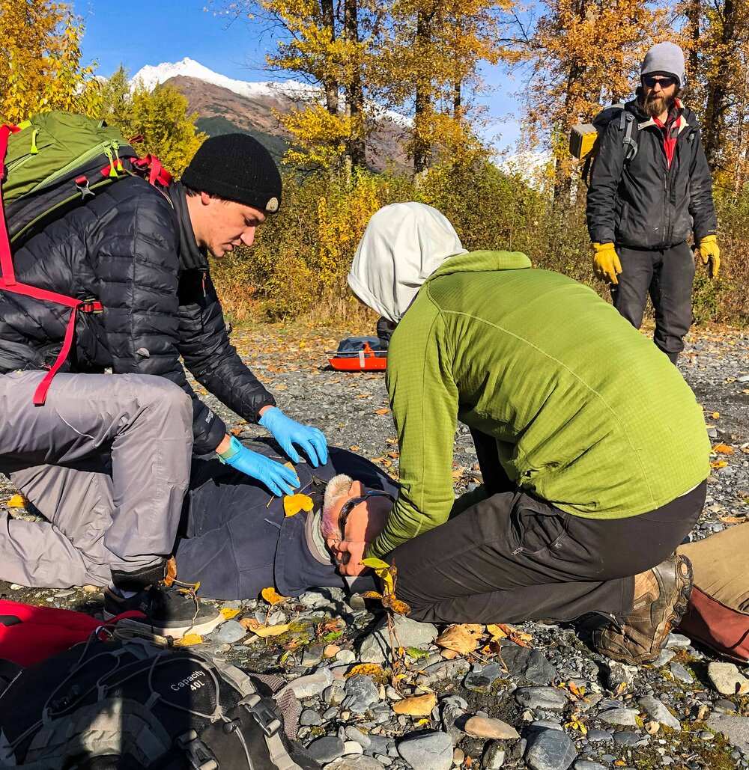
Calling for Help in a Wilderness Emergency
Always have a plan for how to get emergency help.
If a cell phone is available and has service, use it to call 911.
Send two people back to the vehicles and have them drive to the nearest phone or the nearest location with cell service.
Be able to describe the location and directions to get there.
Use three loud noises to signal rescuers (whistle blasts).
Notes:
Many wilderness areas have no cell services. Know where the nearest phone is, or, can you get someplace nearby where your cell phone will work.

Slide 17
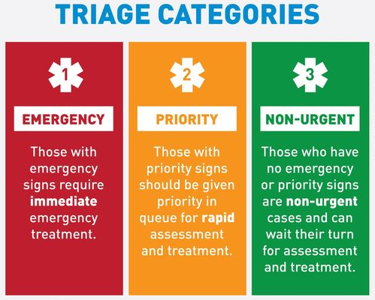
Requirement #3
Define the term triage. Explain the steps necessary to assess and handle a medical emergency until help arrives.

Slide 18
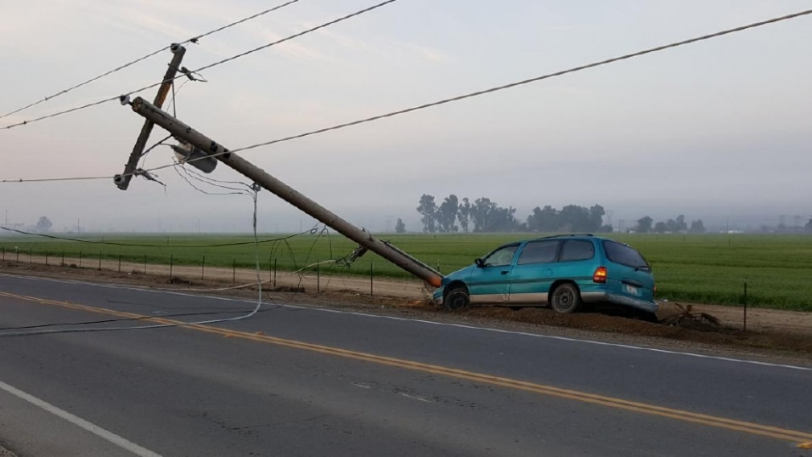
Is It Safe?
Take care of yourself, then your helpers, finally the victim.
Is the scene safe?
What caused this?
Is there anything here that can hurt me?
Notes:
You are the first priority to keep safe…not the victim. After yourself, make sure your helpers are safe, then deal with the victim. No one should be hurt by giving first aid.

Slide 19
Your Steps at an Emergency
Decide to be helpful and prepared before an accident happens.
Recognize the emergency.
Call EMS if required.
Assess the victim.
Provide care.
Everyone of any age can render assistance. Your actions in the first few minutes will make a difference.
Notes:
Unfortunately, most Americans don’t take first aid training and rely too much on calling 911.

Slide 20
Multiple Victims
You must first decide who needs care the most and who can wait until help arrives or others can help.
This process of setting priorities is called “Triage”.

Slide 21
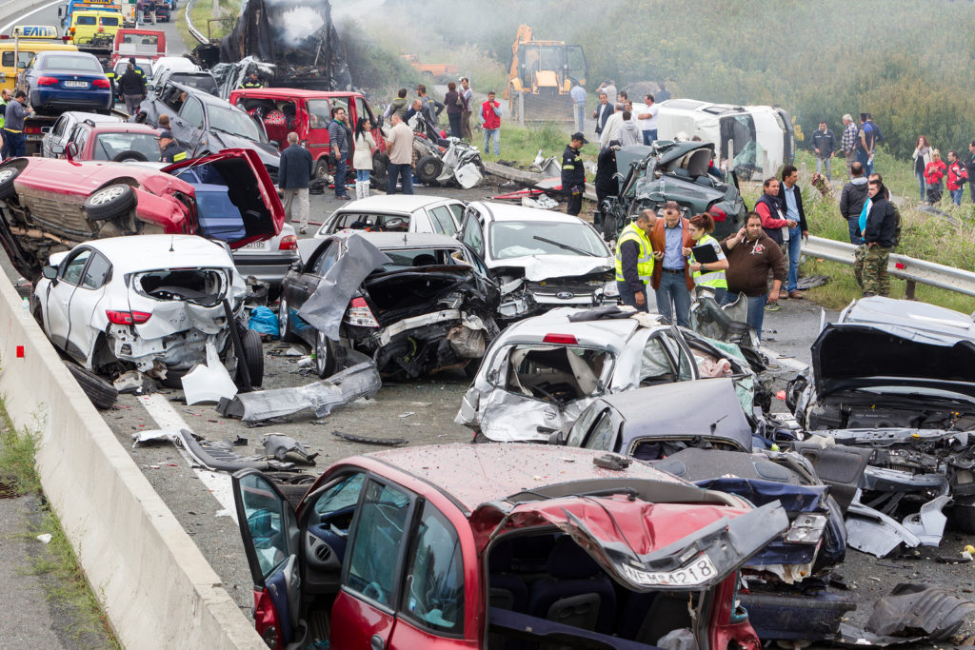
Actions for Multiple Victims Situations
Call 911 immediately.
Tell dispatcher there are multiple victims.
Ask any victims who can walk to move to one side.
These victims do not have immediate life-threatening problems.

Slide 22
Actions for Multiple‐Victim Situations
With remaining victims, start checking for normal breathing with unresponsive victims and look for life-threatening injuries.
Spend 1 minute or less with each victim and do not start giving care until you have checked all victims.
Give care to top priority victims first.
Move to less serious victims only when first priority victims are stable.
When help arrives, quickly tell EMS professionals about victims.

Slide 23
Decision Tree for Multiple‐Victim Situations
Third Priority
No Treatment Needed
Second Priority
First Priority

Slide 24
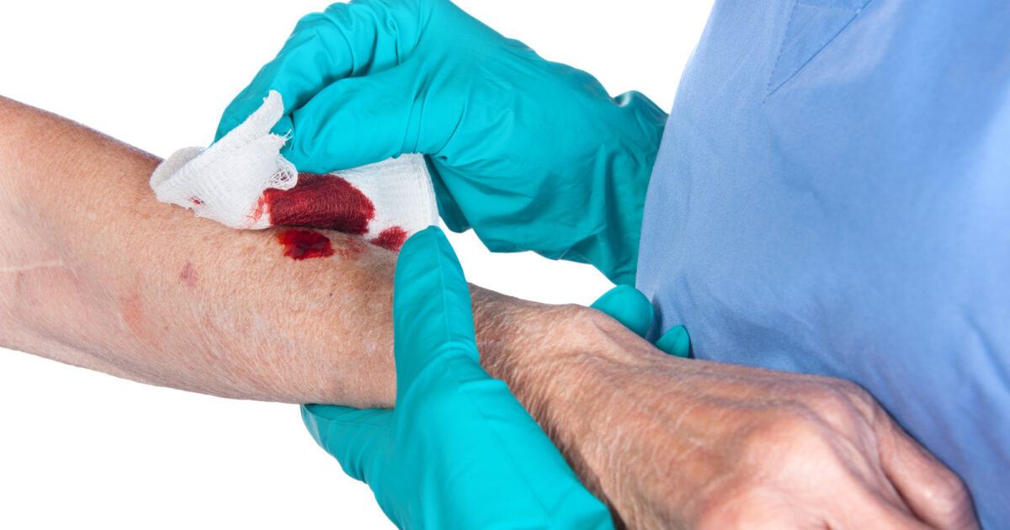
Requirement #4
Explain the precautions you must take to reduce the risk of transmitting an infection between you and the victim while administering first aid.

Slide 25
Blood-borne Disease
Anyone can carry a blood-borne disease.
Don’t think that just because a cut is small your are less at risk.
You don’t want to be contaminated by bacteria or viruses present in blood and other body fluids.

Slide 26
Bloodborne Diseases
The best way to keep yourself safe is to avoid contact with all blood and body fluids.

Slide 27
Use Gloves!!
Use nonlatex medical exam gloves if you can.
Improvise if you do not have medical exam gloves (plastic trash bag, etc.)
Unbroken skin can be an effective barrier, but, a small break in your skin can be a way for disease to enter your body.
Wash your hands before and after.
Cover any cuts/scrapes.
Do not touch your mouth, nose, or eyes when providing first aid.

Slide 28
Barrier Devices
Use a pocket face mask or face shield if available if you have to do CPR.

Slide 29
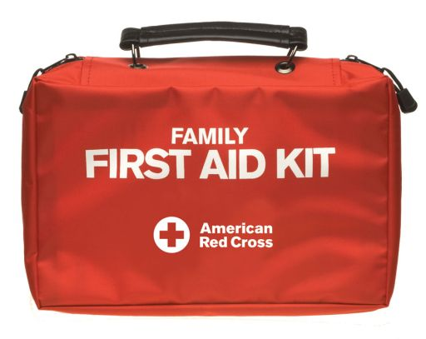
Requirement #5
Do the following:
Prepare a first-aid kit for your home. Display and discuss its contents with your counselor.
With an adult leader. Inspect your troop's first-aid kit. Evaluate it for completeness. Report your findings to your counselor and Scout leader.

Slide 30
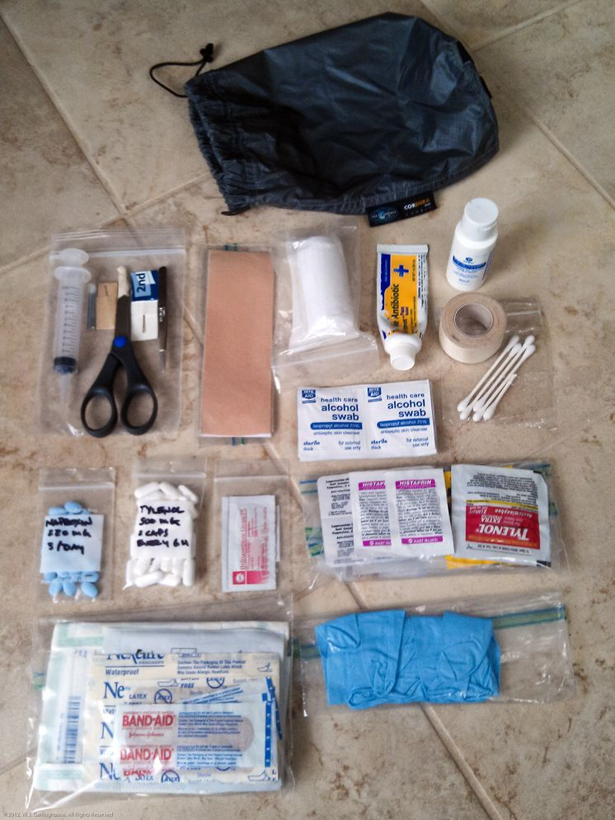
First Aid Kits and Training
Your first aid kit should be suited to the expected use and your training level.
First aid kits need to be convenient to use and in a place where they can be reached easily.

Slide 31
Family/Troop First Aid Kits
At a minimum, the Family/Troop kit should contain the following:
Roller bandage, 2-inch (1)
Roller bandage, 1-inch (2)
Adhesive tape, 1-inch (1 roll)
Alcohol swabs (24)
Assorted adhesive bandages (1 box)
Elastic bandages, 3-inch-wide (2)
Sterile gauze pads, 3-by-3-inch (12)
Moleskin, 3-by-6-inch (4)
Gel pads for blisters and burns (2 packets)
Triple antibiotic ointment (1 tube)
Triangular bandages (4)
Soap ( 1 small bar) or alcohol-based hand sanitizing gel (1 travel size bottle)
Scissors (1 pair)
Tweezers (1 pair)
Safety pins (12)
Nonlatex disposable gloves (6 pairs)
Protective goggles/safety glasses (1 pair)
CPR breathing barrier (1)
Pencil and paper
Emergency First Aid instructions
Check the kit regularly.
Check expiration dates and replace any used or out-of-date contents.

Slide 32
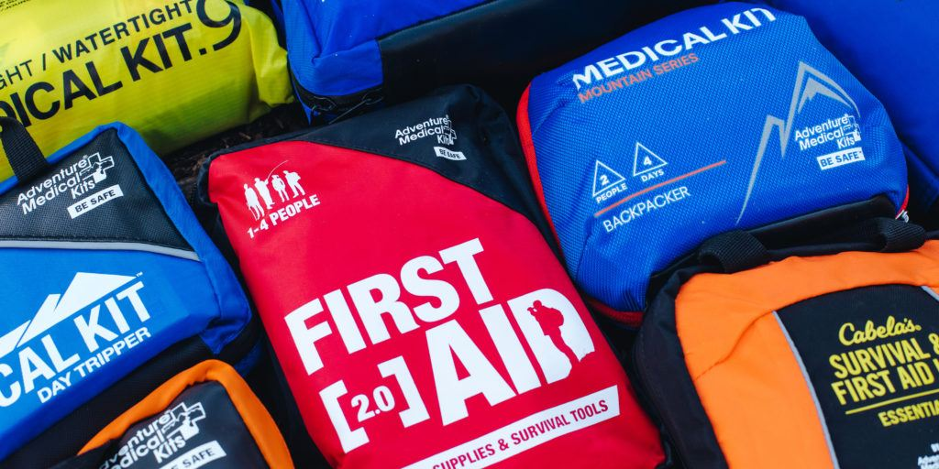
First Aid Supplies
There are many first aid supply sources on the web.
Some items can be purchased cheaply at local stores.
Making your own first aid kit is usually the best option, commercial kits often are missing basic bandages or have too few of critical items.

Slide 33
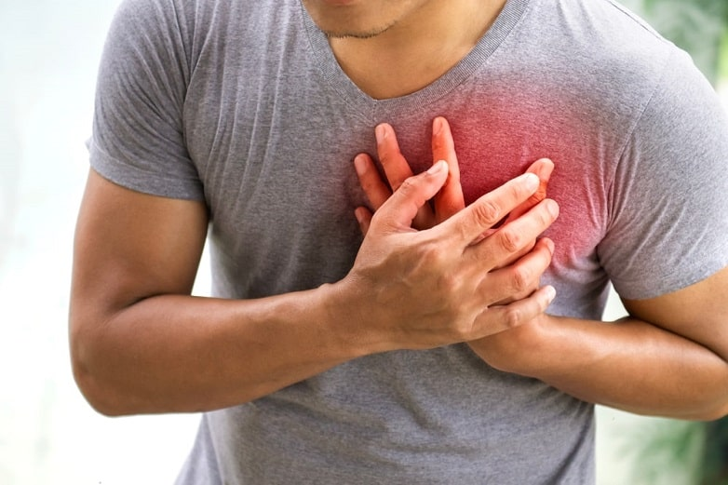
Requirement #6
Describe the early signs and symptoms of each of the following and explain what actions you should take:
Shock
Heart attack
Stroke

Slide 34
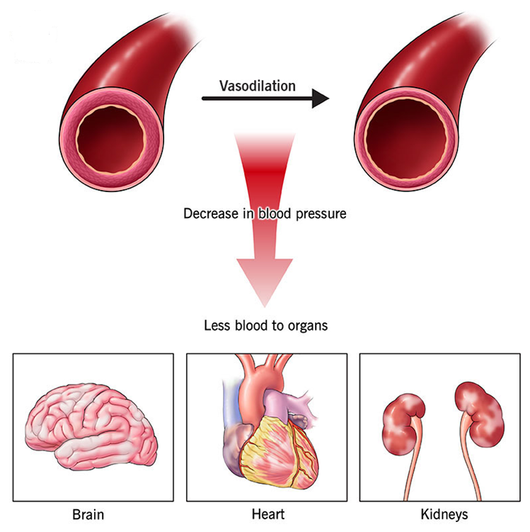
What is Shock?
Not enough blood is getting to the right places around the body.
Can be caused by all kinds of things…both illness and injury.
Untreated – it can lead to death.
Notes:
Shock can be caused by all kinds of things, both minor and major. Treat serious injuries for shock, even if there are no symptoms.

Slide 35
Symptoms of Shock
Dizziness
Pale, cool, moist skin
Rapid, shallow breathing
Nausea/vomiting
Extreme thirst
Rapid, weak pulse
Decreased blood pressure
Mental status changes
Restlessness, anxiety
Notes:
Shock will worsen if it is not treated.

Slide 36
First Aid for Shock
Place the victim in shock position.
Keep the person warm and comfortable.
Turn the victim’s head to one side if neck injury is not suspected.
Notes:
Don’t forget to monitor the airway of an unconscious victim. If they start to vomit turn them on their side.

Slide 37
Heart Attack

Slide 38
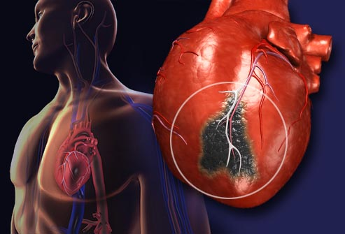
What is a Heart Attack?
Sudden reduced blood flow to the heart muscle due to blockage of an artery.
Signs and symptoms vary considerably.
May have no signs or symptoms before collapsing suddenly or victim may have mild symptoms that come and go for hours or days prior to the attack.
Notes:
There is no typical heart attack. However, the longer there is pain or discomfort the more heart muscle will die.

Slide 39
Signs and Symptoms
Notes:
Not all heart attacks have clear symptoms, especially in the early stages. You must pay attention to all clues and signs.

Slide 40
First Aid for a Heart Attack
If you think someone is having a heart attack:
Call 911
Many experts recommend the victim chewing and swallowing a full dose aspirin (325 mg), after calling 911.
Have the person sit down, rest, and try to keep calm.
Loosen any tight clothing.
Ask if the person takes any chest pain medicine, such as nitroglycerin for a known heart condition, and help them take it.
If the person is unconscious and unresponsive, and not breathing or does not have a pulse, begin CPR.
If an automated external defibrillator (AED) is immediately available - follow the instructions on the AED device.

Slide 41
Stroke
Stroke is a brain injury – blood supply to part of the brain is interrupted.
Headache, dizzy, unusual behavior, passes out, forgets things, slurred speech, weak on one side.
Monitor victim and be prepared to give CPR.
Have victim lie down with head and shoulders slightly raised.
Notes:
Symptoms may be subtle. Not all strokes are dramatic sudden events. This is a challenge when you are someone in denial…”It is just a headache”.

Slide 42
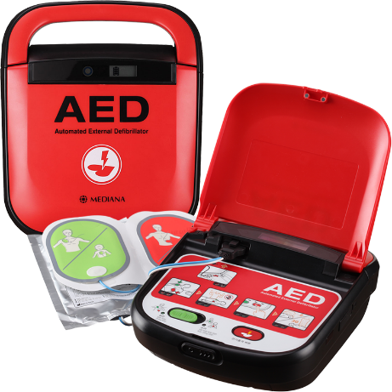
Requirement #7
Do the following:
Describe the conditions that must exist before performing CPR on a person.
Demonstrate proper CPR technique using a training device approved by your counselor.
Explain the use of an automated external defibrillator (AED).
Demonstrate or simulate the proper use of an automated external defibrillator (AED), using an AED training device if available.
Identify the location of the AED at your school, place of worship, and troop meeting place, if one is present.

Slide 43
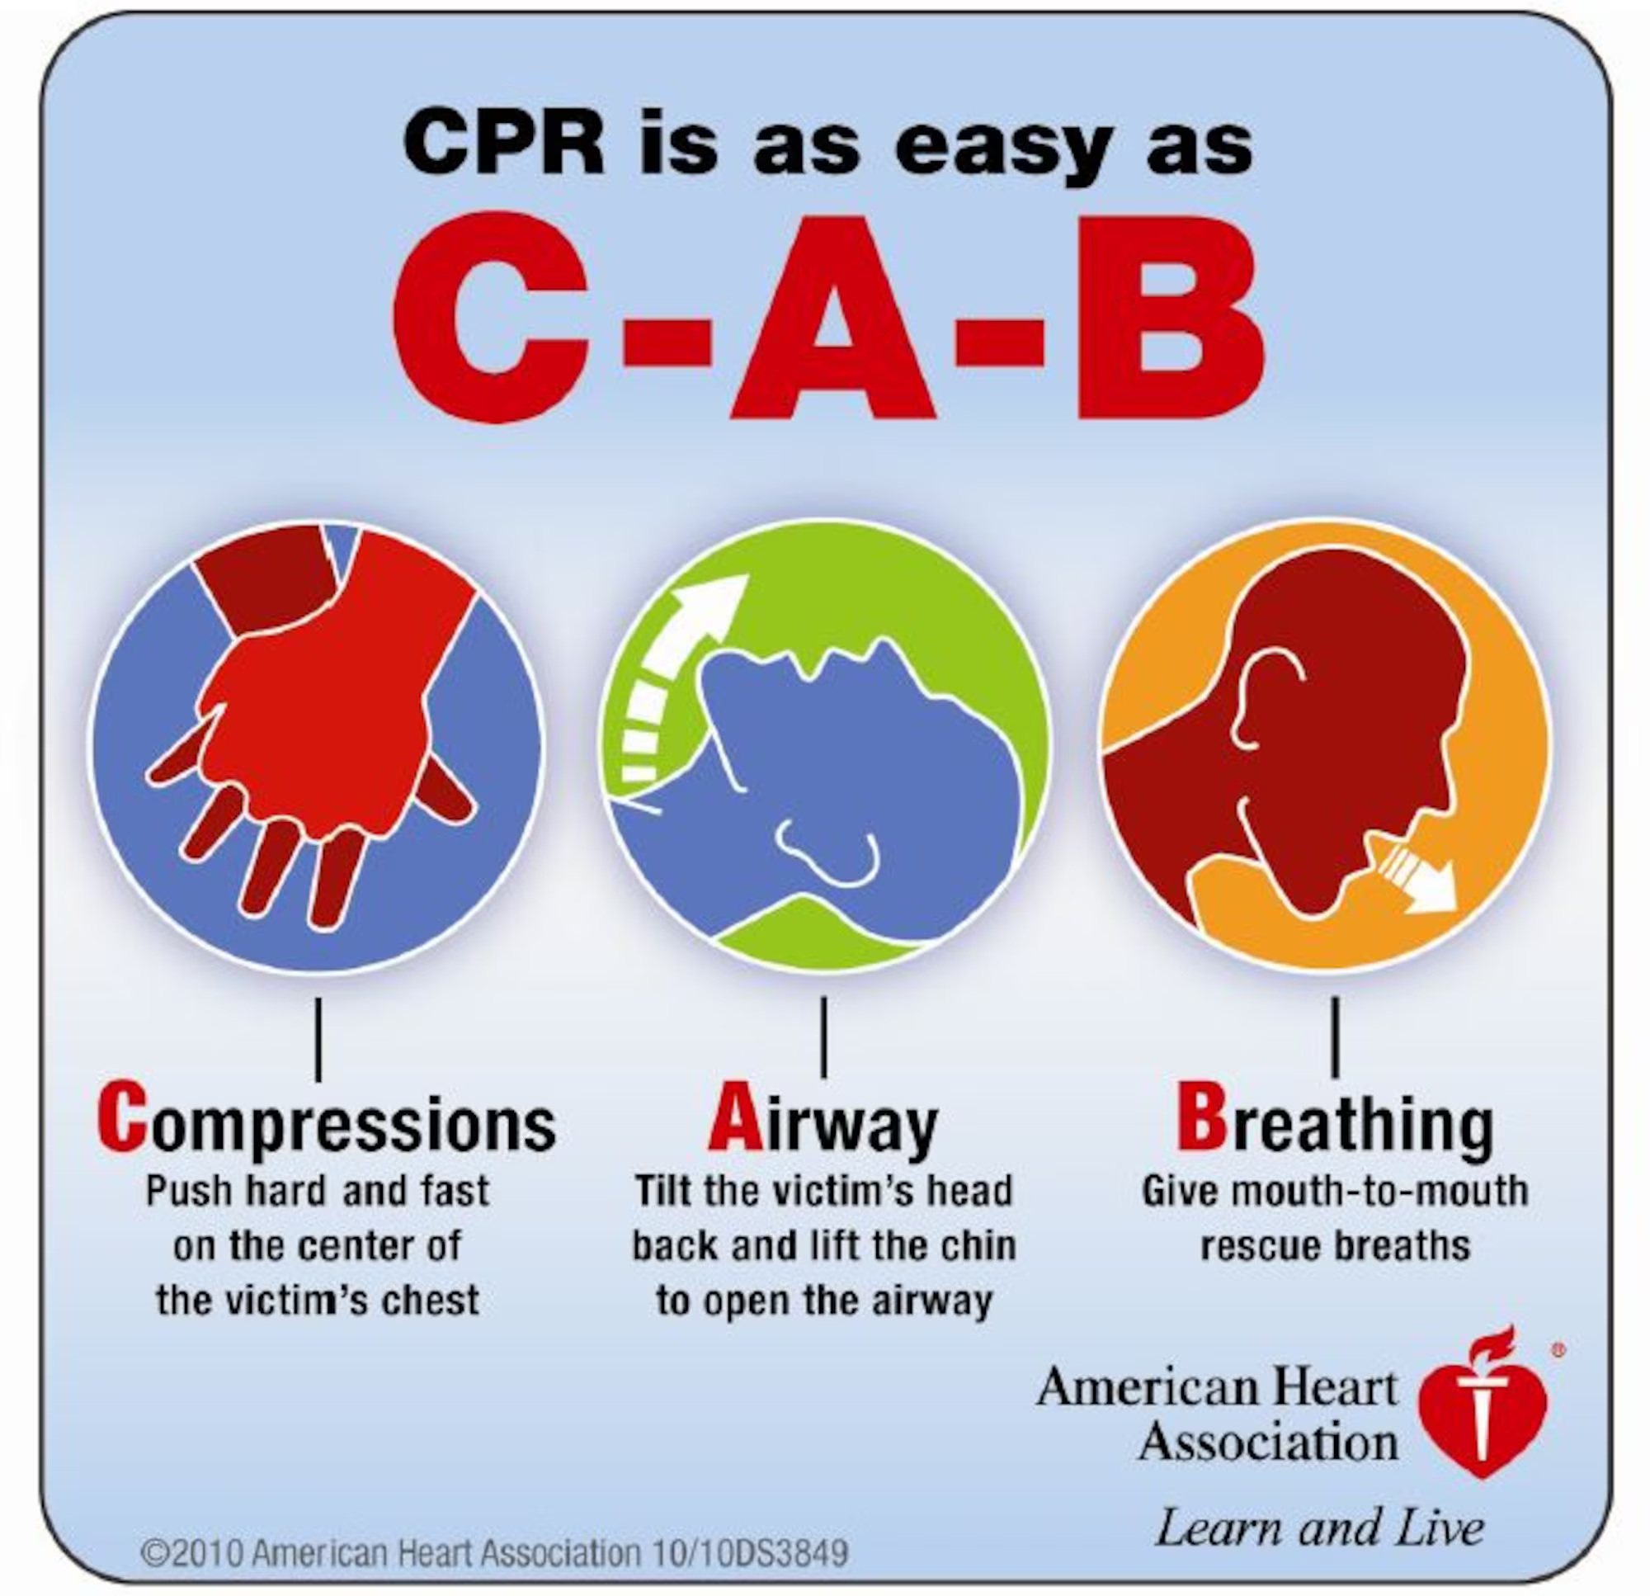
CPR Protocols
The A‐B‐C order for CPR (Airway‐Breathing‐Circulation) has been changed to C‐A‐B (Compressions‐Airway‐Breathing)
This is based on medical research that shows CPR is more effective if done first and promptly.
Volunteers will no longer check for a pulse or Look‐Listen‐Feel for breathing.
Notes:
C‐A‐B is the new protocol for CPR. There are still many books and web sites that are pending revision. If you hear about A‐B‐C’s that is old guidance. Follow C‐A‐B.

Slide 44
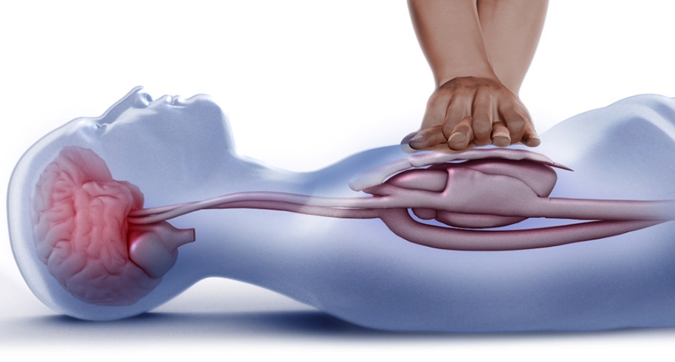
New CPR Protocols
Are you OK? – Check responsiveness.
Unresponsive? Assess breathing by looking at the victim (DO NOT open airway yet by tilting head…DO NOT Look-Listen-Feel).
Not breathing? Call 911 and send for AED if available.
Start with 30 compressions and then two breaths.
Continue with CPR – 30 compressions, then 2 breaths.
Notes:
We don’t look‐listen‐feel anymore by putting our ear next to the victim’s face. Just look at the victim. If they don’t look like they are breathing then begin CPR. Tap the shoulder and ask if they are ok. This is the way first aid volunteers check responsiveness.

Slide 45
CPR Technique
Position on their back.
If victim appears to be not breathing or is gasping call 911, get AED, and start CPR.
Use a barrier device if you have one.

Slide 46
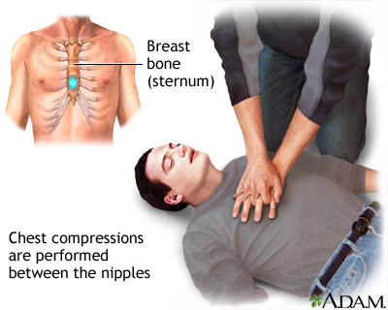
CPR Technique
30 compressions
Notes:
Go up and down smoothly. Don’t stab or jerk the compressions. The rate is important, too. Counting out loud will let others in the area know that CPR has started and will help your breathing. This is hard work. The rate of 100/minute is a minimum.

Slide 47
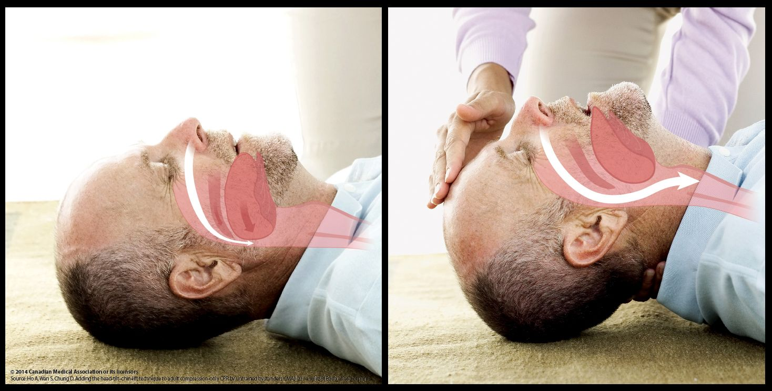
CPR Technique
Open the airway
Use the head-tilt-chin-lift technique
Notes:
This is the head tilt chin lift. Do not lift the neck from behind. Use hands as shown.

Slide 48
Rescue Breathing
Two breaths
Notes:
Each breath should last about a second.

Slide 49
Give 30 compressions at a speed of 100 per minute
Then give 2 breaths
If you don’t remember how to do breaths then just do continuous chest compressions.
If you don’t want to do breaths then just do continuous compressions.
Notes:
The recommended ratio is 30 compressionsn to two breaths. This if for adults, children, and infants.

Slide 50
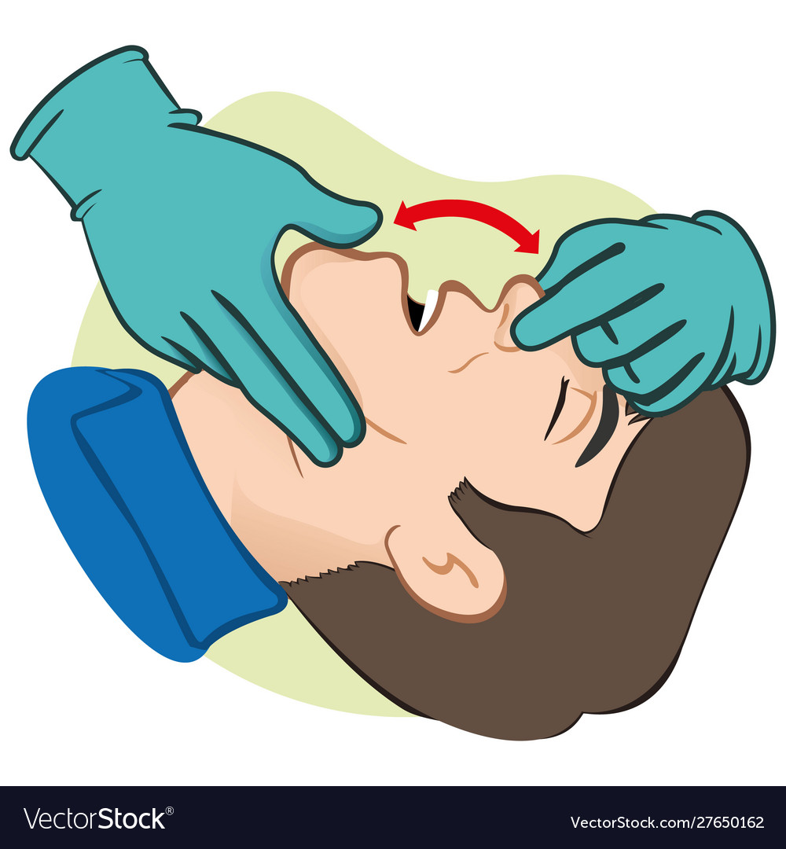
Check Airway
If victim may have been choking, check for object before giving rescue breaths. If you see obstruction, remove it.
Then continue CPR.
Notes:
If air does not go in retilt the head and try again. If you can’t get air in apply choking protocols. Use full CPR and check for an object before you attempt to put in breaths. The CPR compressions may push the object up to where you can see it. No blind finger sweeps. If you see an object get it. Otherwise continue CPR with choking protocols.

Slide 51
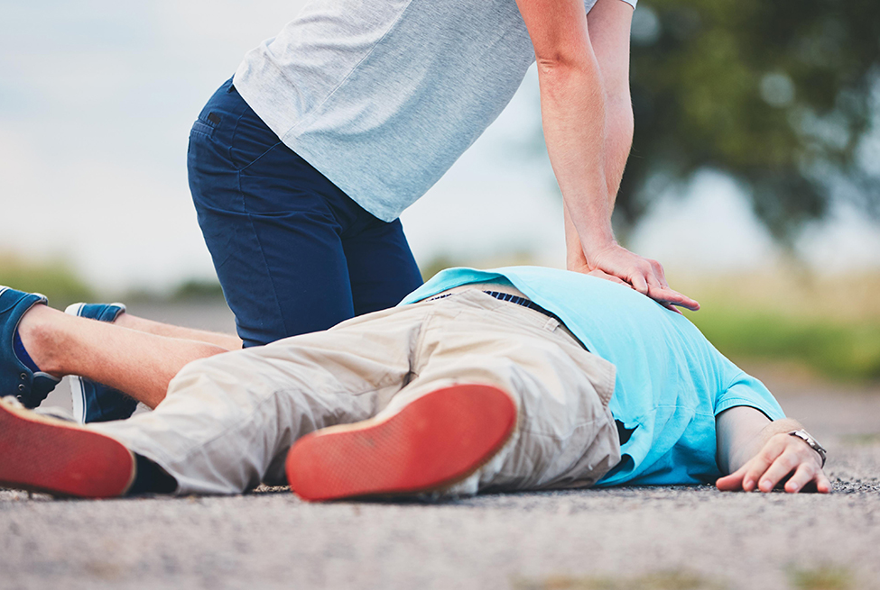
Continue CPR until…
Victim moves.
AED arrives and is ready to use.
Help arrives.
You are too tired to continue.
Notes:
Do not check for breathing with look‐listen‐feel. That is old protocols. Don’t check for once you start CPR. While the AED is being set up continue CPR. When help arrives continue CPR until you are
Told to stop.

Slide 52
What happens if I don’t remember?
If you don’t exactly remember the steps of CPR, do the best you can!
If you can’t figure out the breaths, then perform continuous chest compressions.
With a heart in trouble, it is always better to try some kind of CPR than do nothing.
Always call for help quickly.

Slide 53
Practice
CPR
Notes:
Instructors need to talk the scouts through the first cycle – this is step‐by‐step. There is no CPR video like a first aid class so the presenter must talk them through the first time. Repeat the practice for a total of three times if time permits. Make sure the scouts do the CPR correctly. Make positive comments as well as corrections.

Slide 54
AED
Automated External Defibrillator
Notes:
The AED is a key reason why survival rates from heart attacks are rising. We are getting CPR and AED help on the victim quickly and properly.

Slide 55
AED
Portable.
Pads placed on the victim’s chest.
Unit analyzes victim’s heart and advises whether to give a shock.
All AED’s work the same.
Notes:
The AED is automated with regards to analyzing the heartbeat and deciding if a shock is appropriate. The user still has to clear responders away from the victim and push a button to supply the shock. The AED will not shock unless a specific heart abnormal rhythm is detected.

Slide 56
Clothing Removal
It may be necessary to open/remove the shirt to find the nipples.
It is always necessary to open/remove the shirt to deploy the AED.
Put arms back at sides for CPR/AED.
Notes:
You need to be able to find the landmarks to have the correct position for compressions. If an AED is being used you will need to put the pads on a bare chest.

Slide 57
How AEDs Work
Heart’s electrical system keeps chambers of the heart synchronized and working together.
With heart attack or other heart problems, this rhythmic electrical system may be disrupted.
Sometimes an AED shock restores regular heart rhythm – this is “defibrillation”.
Notes:
The AED is automated with regards to analyzing the heartbeat and deciding if a shock is appropriate. The user still has to clear responders away from the victim and push a button to supply
The shock. The AED will not shock unless a specific heart abnormal rhythm is detected.

Slide 58
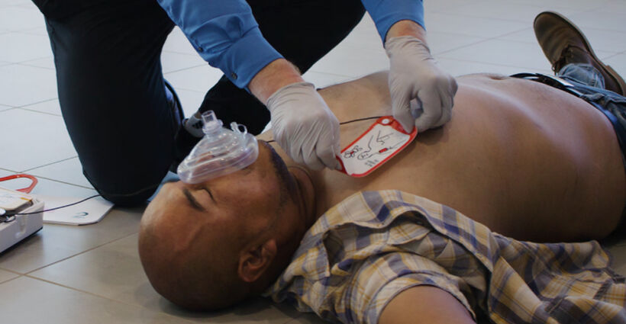
Using an AED
Whenever a victim suddenly collapses or is found unresponsive consider possibility of cardiac arrest.
Send someone to get an AED immediately.
It is better to have it right away and not need it, than to need it and have to wait for it.
Notes:
If we can deploy the AED in time and use it quickly survival rates for the victim will increase.

Slide 59
Using an AED
Turn the AED on and follow the voice prompts.
Keep CPR going while AED is being set up.
Notes:
Time is critical. Leadership is necessary from the responder. Get help from bystanders and deploy the AED quickly. However, as in all first aid situations, don’t panic or go so fast you make mistakes. Apply CPR and the AED quickly, calmly, promptly, and correctly.

Slide 60
Using an AED
Check the pictures on the pads.
Some are interchangeable placement, others are not.
Notes:
Some AED units have the pads already attached. Others will have the pads in a separate package which you have to open.

Slide 61
Using an AED
Follow placement diagram on the pads.
Notes:
The underside is sticky and will work if the victim is dry and not too hairy. If there is a lot of chest hair use the razor in the AED kit to shave a palm sized area for the pad.

Slide 62
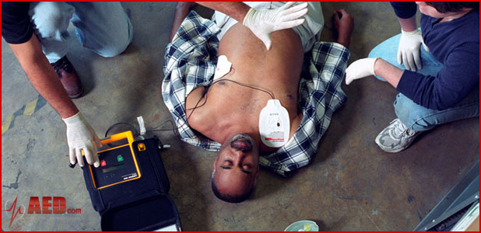
Using an AED
Follow placement diagram on the pads.
If the AED advises shock say: “Everyone Clear!”
and make sure they are at least 6” away.
Notes:
The AED will tell you to discontinue CPR and not touch the patient. Then, after analysis, will tell you to continue CPR (no shock) or to apply a shock. Clear everyone away from the patient at least six inches and push the button to deliver the shock.

Slide 63
Give shock (push button) when AED says so
Notes:
Don’t forget to clear the bystanders and helpers away from the victim before pushing the button to shock.

Slide 64
Start CPR after the shock. Leave AED on and pads attached.
Notes:
Start CPR immediately after the shock.

Slide 65
AED Use in Children
If pediatric pads are available use them on children (not adults).
If there are no pediatric pads you can use adult pads on children.
Use pediatric pads on infants (put front and back). Use adult pads on infants if nothing else is available.
Notes:
Some units include pediatric pads.

Slide 66
AED
Demonstration
Notes:
Do the demonstration on either a live scout, or, use a CPR dummy. Do the demo using the scouts and make it as realistic as possible. This is a demonstration only – the scouts do not have to practice this.

Slide 67
Near Drowning

Slide 68
Be Safe – Do It Smart
Use “safe swim” procedures around any water activity.
If you are involved with the rescue, use “reach, throw, row, go”.
Do not attempt a swimming rescue unless you are a trained lifeguard.
Remember, you can start rescue breathing in the water. Compressions can only be done out of the water.
Start CPR if victim is not breathing.
If victim is breathing and their heart is beating, roll on left side and monitor airway. They may vomit!

Slide 69
Requirement #8
Do the following:
Show the steps that need to be taken for someone who has a large open wound or cut that is not bleeding severely.
Show the steps that need to be taken for someone who has a large open wound or cut that is severely bleeding.
Explain when it is appropriate and not appropriate to use a tourniquet. List some of the benefits and dangers of the use of a tourniquet.
Demonstrate the application of a tourniquet without tightening it.

Slide 70
Nonbleeding Wounds
If the cut is not bleeding or you were able to stop the bleeding:
Wash your hands first and wear gloves if available.
Rinse the cut well with water to clean out dirt and debris.
Wash the skin around the cut with a mild soap and rinse well.
Cover the wound with a clean bandage or clean gauze and tape.
Change the bandage each day or any time it gets wet.

Slide 71
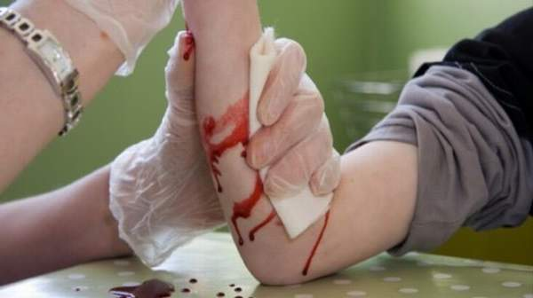
Bleeding Control
The best method to control bleeding is direct pressure.
Elevation above the heart will also help slow bleeding.
Notes:
The good news is the body’s ability to stop bleeding for most trauma. However, without help from the first aid volunteer a significant volume can be lost. Loss of blood is a life threatening condition.

Slide 72
Direct Pressure
Apply pressure directly to the wound.
56
Notes:
Direct pressure is the best method.

Slide 73
Puncture Wounds and Lacerations
If an object is embedded, don’t pull it out. Bandage in place.
If the object has already been removed wash thoroughly – infection is more likely because germs have been pushed deeper in the body.
May still need a doctor’s care – you can’t see how deep it went or what is going on inside the body.
Notes:
If the item falls out while putting on a dressing don’t worry…adjust your bandange and make sure the bleeding is controlled.

Slide 74
Bandaging

Slide 75
Bandaging Techniques
There are different techniques for different types of bandages and locations of the wound.
Even small wounds need cleaning and bandaging.

Slide 76
Band‐Aids – Use them correctly!
Notes:
Even a Band-Aid can be used incorrectly! Clean the cut, dry the skin, and keep the underside of the Band-Aid clean.

Slide 77
Technique for Roller Bandage
Use gauze pad if you have one.
Hold end in place for first turn of bandage.
Unroll gauze as you bandage (don’t unroll first.)
Notes:
Use gauze pads to help stop the bleeding, although the roller gauze can be a bandage without gauze pads.

Slide 78
Technique for Roller Bandage
Cover the cut with a crisscross pattern (figure 8).
Make a loop in final turn to tie off.
Notes:
Explain how the gauze is applied to the victim from the roll and that the roll should be started as illustrated. Make sure students understand how the direction change works.

Slide 79
Technique for Roller Bandage
Use the ends of the bandage to tie a bow knot over the cut.
Notes:
Using a bow knot allows the dressing to be adjusted for more/less pressure without have to cut the bandage.

Slide 80
Technique for a Triangular Bandage
Triangular bandages can also be a dressing.
It is more than just a sling!
Notes:
Even a triangular bandage works on a cut. It can be used for splints, too. It is more than a sling.

Slide 81
Technique for a Self‐Adherent Dressing
Use a gauze pad underneath to cover the wound.
Notes:
Demonstrate the use of a self‐adherent dressing.

Slide 82
Bandage a cut on a forearm.
Practice
Bandage
Notes:
Make sure they are doing the bandages correctly. Make them re‐do incorrect bandages.

Slide 83
Tourniquets
Tourniquets should be used when the bleeding cannot be stopped by the use of direct pressure alone.
Tourniquets should only be applied to treat limb injuries.
Do not apply a tourniquet to the joint.
Depending on the location of the wound and its proximity to the joint, it may need to be placed just above the joint.
The tourniquet should be tight enough to stop the bright red bleeding.
A tourniquet should only be used in an emergency until you’re able to receive immediate medical attention.
It can be applied for approximately two hours before neurovascular injury occurs.
Do not remove a tourniquet yourself. A medical professional should do it for you.

Slide 84
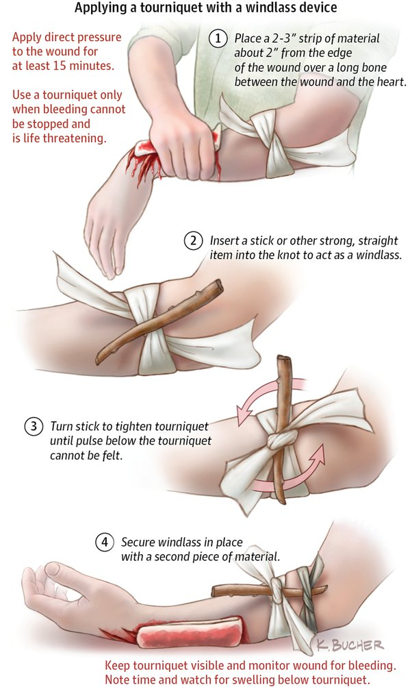
How to Apply a Tourniquet
Place the tourniquet between the wound and the heart.
Wrap the material around the limb.
The material should sit as flatly as possible against the skin to prevent damage.
When using fabric, knot a stick or other rigid object, like a pen, on the outside layer of the tourniquet to create a torsion device.
Twist the stick to tighten the tourniquet until the pulse below the tourniquet cannot be felt.
Knot it again to keep it in place.
Immobilize the injured area and note the time the tourniquet was applied.

Slide 85
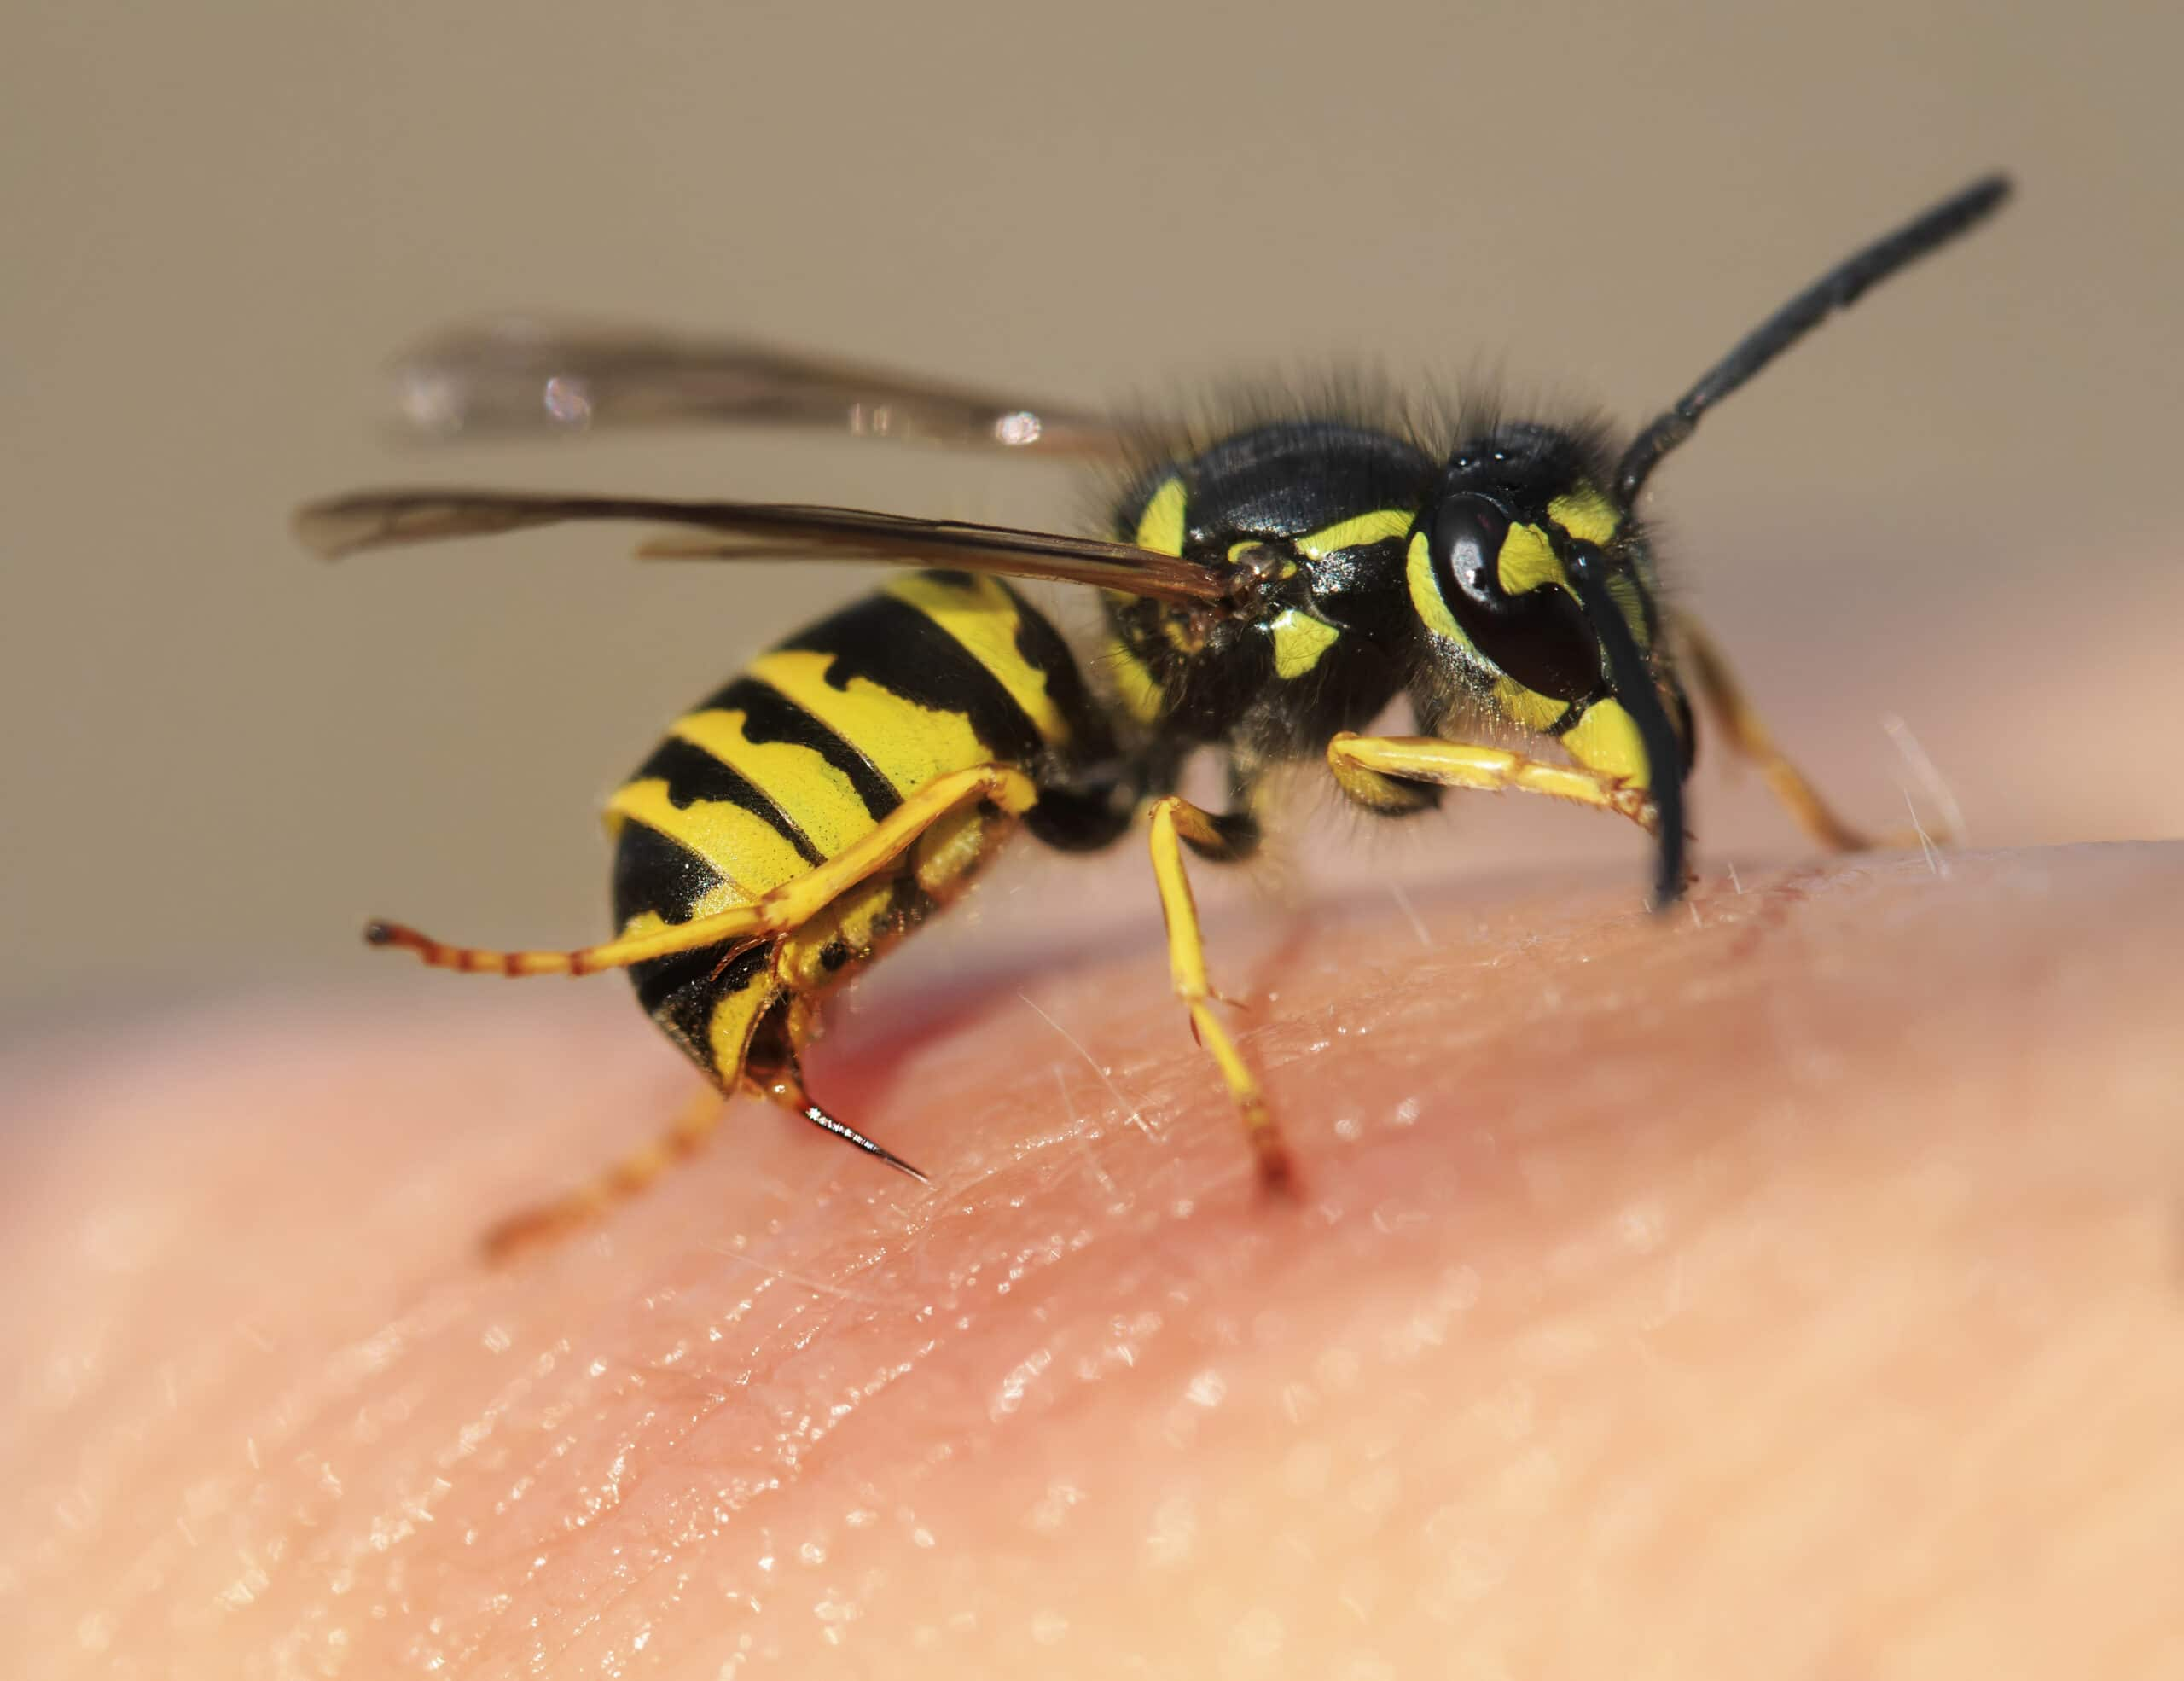
Requirement #9
Explain when a bee sting could be life threatening and what action should be taken for prevention and for first aid.

Slide 86
Preventing Bee and Wasp Stings
Avoid flowering plants, gardens, and trees with ripe fruit, where bees spend their time.
Never slap at a bee or wasp.
Remain calm and still if a single stinging insect is flying around.
Swatting at an insect may cause it to sting.
If you are attacked by several bees at once, run to get away from them.
Bees release a chemical when they sting, which may attract other bees.
Wearing light-colored clothing and avoiding wearing floral or brightly colored clothing.
Avoid perfumes, scented soaps, shampoos, and deodorants.
Notes:
You never know when someone is going to have their first allergic reaction to a bee sting. People who have been previously stung without a reaction can still have a full body allergic reaction when stung later on.

Slide 87
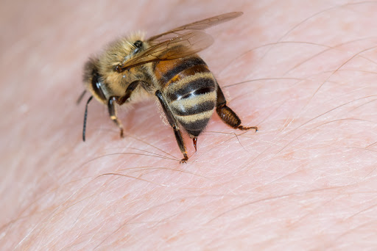
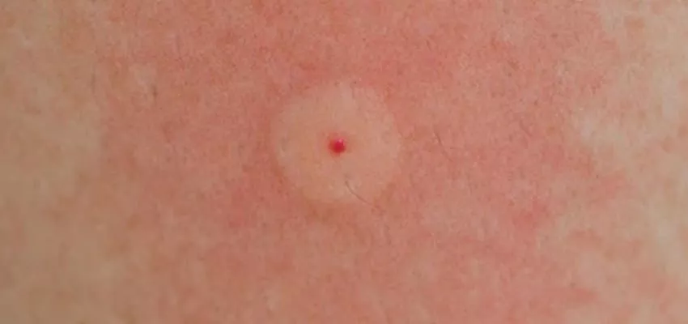
Bee and Wasp Stings
Insect stings can cause life- threatening allergic reactions in sensitive victims.
Pain, burning, or itching at sting site.
Redness, swelling.
Remove stinger if still in skin.
Notes:
You never know when someone is going to have their first allergic reaction to a bee sting. People who have been previously stung without a reaction can still have a full body allergic reaction when stung later on.

Slide 88
First Aid for Bee and Wasp Stings
Remove stinger from skin by scraping it away gently with a credit card or edge.
Wash area with soap and water.
Put ice pack on sting site.
Watch victim for any signs or symptoms of allergic reactions.
If symptoms occur, call 911 and treat for shock.
Notes:
The stinger will continue to inject venom into the victim. Remove the stinger as soon as possible.

Slide 89
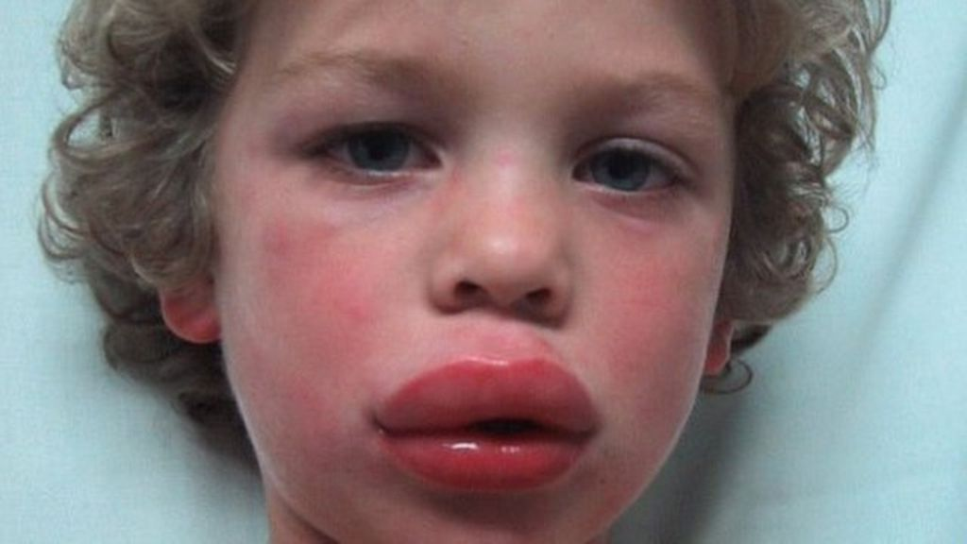
Symptoms of Allergic Reactions
Difficulty breathing, wheezing.
Tightness in throat or chest.
Swelling of the face and neck, puffy eyes.

Slide 90
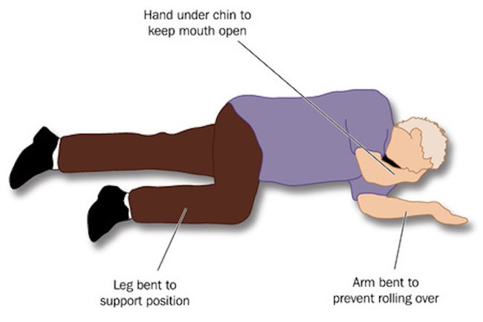
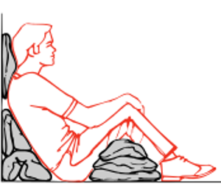
First Aid for Anaphylaxis (Severe Allergic Reactions)
Call 911.
Lay person flat – do not allow them to stand or walk.
If unconscious, place in recovery position.
If breathing is difficult allow them to sit up.
Give adrenaline autoinjector (EpiPen).
Monitor the victim’s breathing and be prepared to give CPR.
Notes:
Definitely get help on the way. There is not much you can do as a first aid volunteer if their airway swells shut. You can help a victim use their EpiPen.

Slide 91
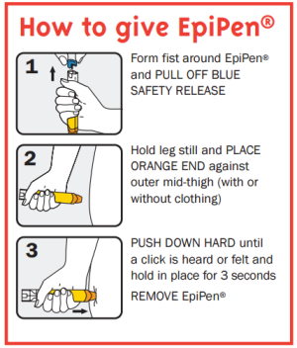
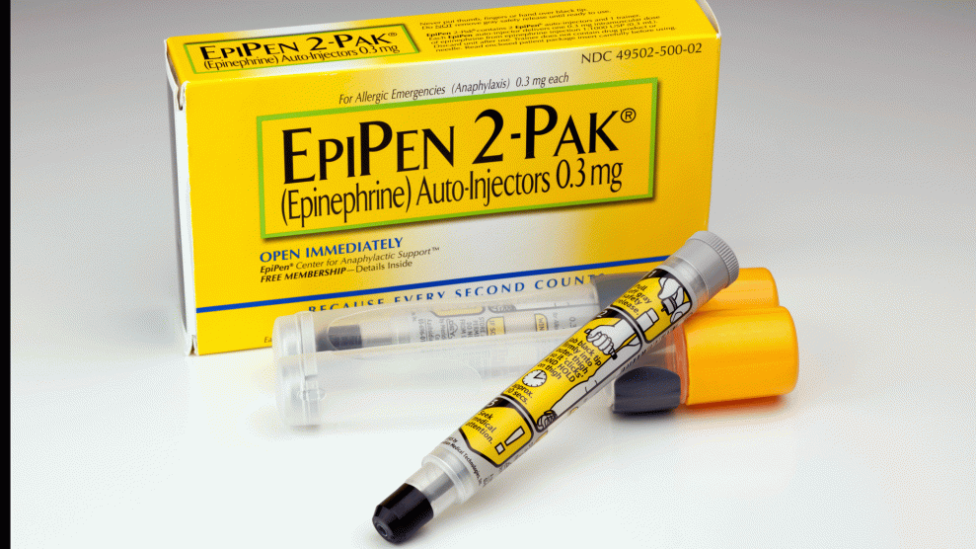
First Aid for Anaphylaxis (Severe Allergic Reactions)
Emergency Epinephrine Kit (EpiPen)
May be carried by people with severe allergies.
Help the victim open and use the kit as needed.
Notes:
Don’t wait for symptoms to get serious. Help them take their epi shot as soon as there are difficulties.

Slide 92
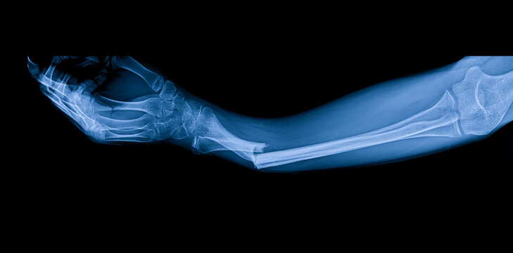
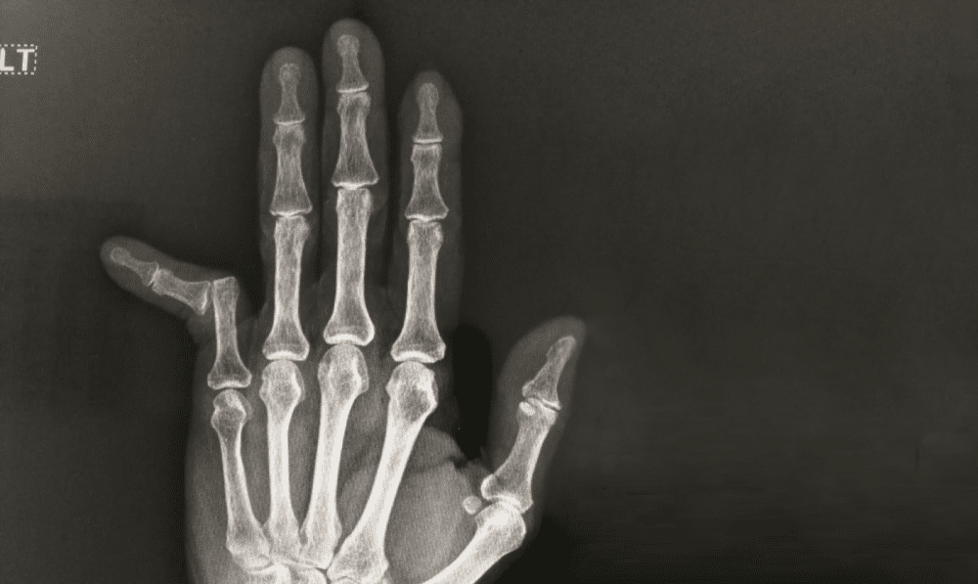
Requirement #10
Describe the signs, symptoms, and potential complications of a fracture and dislocation.
Fracture
Dislocation

Slide 93
Fractures and Joint Injuries

Slide 94
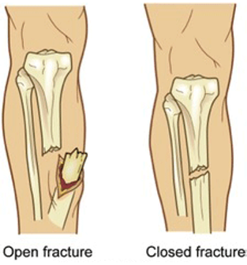
Fractures
Types of fracture include:
Closed (simple) fracture – the broken bone has not pierced the skin.
Open (compound) fracture – the broken bone juts out through the skin, or a wound leads to the fracture site. Infection and external bleeding are more likely.
Notes:
Bones give the body shape.

Slide 95
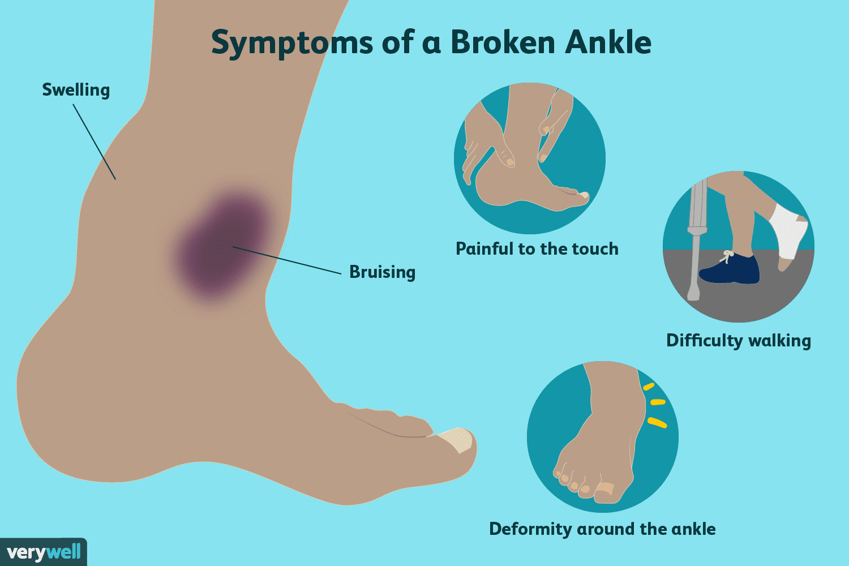
Fractures
Symptoms of a fracture depend on the particular bone and the severity of the injury, but may include:
pain
swelling
bruising
deformity
inability to use the limb.
Complications of bone fractures:
Blood loss – bones have a rich blood supply. A bad break can make you lose a large amount of blood.
Injuries to organs, tissues or surrounding structures.
Stunted growth of the bone – if a child’s long bone breaks close to the joint where the growth plates are found.
Notes:
Bones give the body shape.

Slide 96
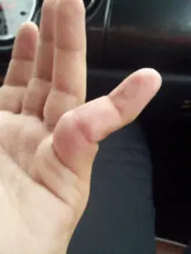
Dislocations
Signs of a dislocation:
Joint is visibly deformed or out of place.
Symptoms of a dislocation:
Numbness or tingling at the joint.
Swollen or discolored.
Limited ability to move.
Intense pain.
Complications of a dislocation:
Complications (such as blood vessel and nerve damage and infections) can occur during the first hours or days after the injury.
Notes:
Bones give the body shape.

Slide 97
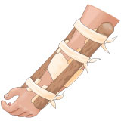
Requirement #11
Demonstrate the proper procedures for handling and immobilizing suspected closed or open fractures or dislocations of the:
Finger
Forearm
Wrist
Upper leg
Lower leg
Ankle

Slide 98
First Aid for Fracture
With open fracture, cover wound with dressing and apply gentle pressure around the site if needed to control bleeding.
If help may be delayed or if victim is to be transported, immobilize with a splint.
Notes:
You will probably not be able to tell the difference between the various types of injuries (fracture, sprain, strain, dislocation). For the volunteer, the appropriate action is to splint, wrap, immobilize, compress, transport to ems, or call ems. The same first aid works for all types.

Slide 99
Splinting
Splint the extremity if:
The victim is at risk for moving injured area (unless help is coming soon).
Before transporting victim to healthcare provider.
It prevents further injury, reduces pain, and minimizes bleeding and swelling.
Notes:
Remind the scouts that when help is close by, there is often no need to splint. Just hold the injury immobile until the ambulance arrives.

Slide 100
Types of Splints
Rigid Splints – made from a board, plastic, rolled newspaper, or thick cardboard.
Soft Splints – made from a pillow, folded blanket, towel, or a triangular bandage.
Anatomic Splints – bandage an injured leg to the uninjured leg, taping fingers together.
Notes:
If you have to make a splint improvise.

Slide 101
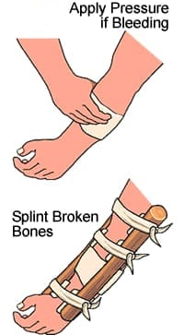
Guidelines for Splinting
Put a dressing on any open wound before splinting area.
Put padding between splint and skin.
Put splints on both sides of a fractured bone if possible.
Apply cold packet to injury around splint.
With splinted extremity, check the fingers or toes to make sure circulation is not cut off.
Notes:
Control bleeding before you apply a splint. Swelling is the most common sign of a fracture. A cold pack will help control the swelling. You can put a cold pack under a sling, but never under a splint.

Slide 102
Securing Splints
Use bandages, strips of cloth, tape, or straps around splint and extremity.
Use knots that can be untied.
Do not secure with tape directly on skin or if it will cut off circulation.
Notes:
Keep checking to make sure swelling has not cut off circulation.

Slide 103
Arm Sling
Sling keeps arm from moving.
A good sling keeps the hand higher than the elbow.
Tie the knot on the side of the neck for comfort.
Notes:
The bottom picture utilizes a binder which keeps the arm even tighter.

Slide 104
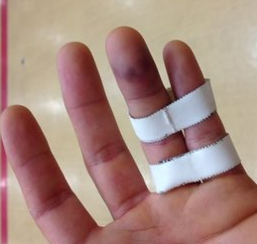
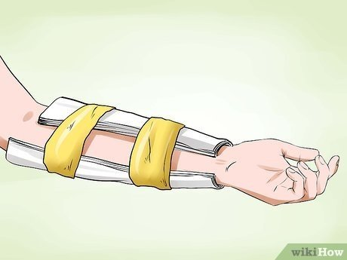
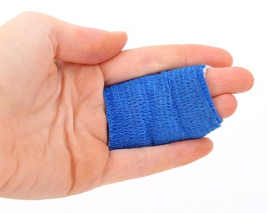
Splints
Finger Splint
Forearm Splint
Notes:
Keep checking to make sure swelling has not cut off circulation.

Slide 105
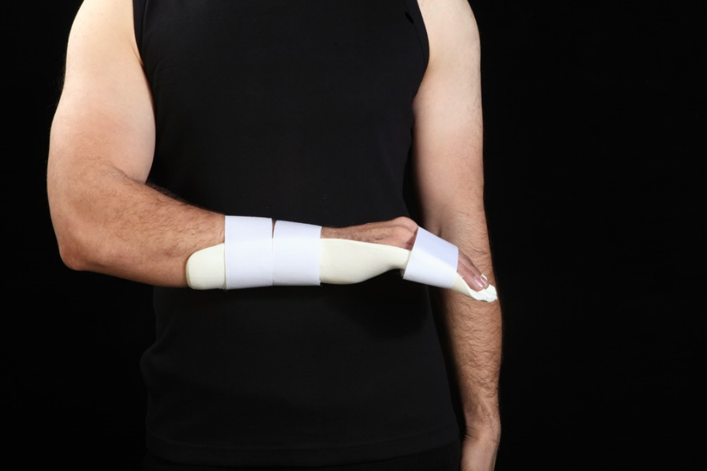
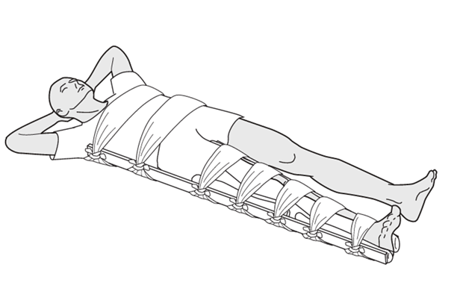
Splints
Wrist Splint
Upper Leg Splint
Notes:
Keep checking to make sure swelling has not cut off circulation.

Slide 106
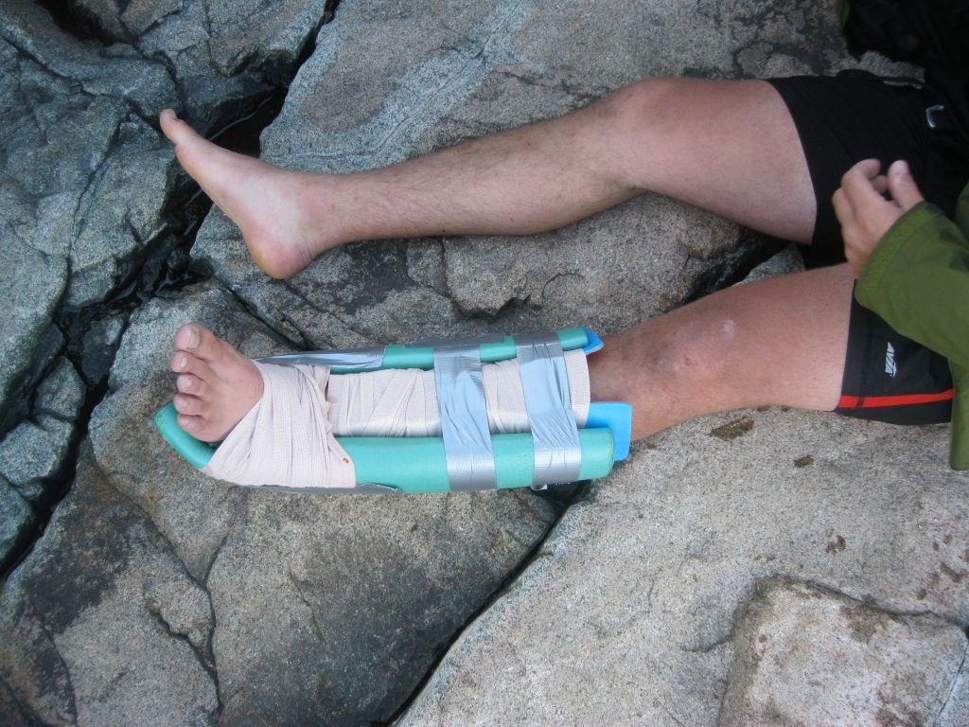
Splints
Lower Leg Splint
Ankle Splint
Notes:
Keep checking to make sure swelling has not cut off circulation.

Slide 107
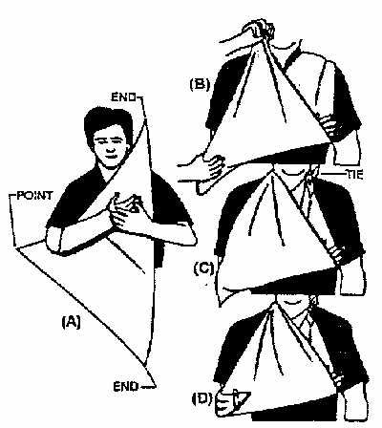
Arm Splint and Arm Sling
Practice
Notes:
Don’t allow practice of bad technique. Have scouts repeat until they get it right.

Slide 108
Requirement #12
Describe the signs, symptoms, and possible complications and demonstrate care for someone with a suspected injury to the neck or back.

Slide 109
Signs of a Head/Neck/Back Injury
Assume a neck injury with any head injuries.
Inability to move.
Lack of sensation or tingling in hands.
Deformed neck or back.
Breathing problems.
Headache.
Signs of blow to head or back.
Notes:
Implement immobilization of the head, neck, and spine if you see these signs.

Slide 110
Head/Neck/Back Injuries
May be life threatening and can cause permanent paralysis.
Call 911.
Do not move the victim any more than necessary.
Keep victim still and support the head and neck to prevent worsening the injury.
DON’T move head if performing CPR.
Notes:
Help the victim keep their head still and stabilized.

Slide 111
Requirement #13
Describe the symptoms, proper first-aid procedures, and possible prevention measures for the following conditions:
Concussion
Anaphylaxis/allergic reactions
Asthmatic attack
Bruises
Sprains or strains
Hypothermia
Frostbite
Burns - first, second, and third degree
Convulsions/seizures
Dehydration
Muscle cramps
Heat exhaustion
Heat stroke
Abdominal pain
Broken, chipped, or loosened tooth

Slide 112
Concussion Symptoms
Concussion is the sudden but short-lived loss of mental function that occurs after a blow or other injury to the head.
Symptoms of concussion include brief:
loss of consciousness after the head injury.
periods of memory loss.
disturbances in vision, such as “seeing stars” or blurry vision.
a period of confusion, a blank expression, or a delay in answering questions immediately after the head injury.

Slide 113
Concussion First Aid
Call 911
Administer the following first-aid steps while waiting for emergency medical help to arrive:
Keep the person still. The injured person should lie down with the head and shoulders slightly elevated. Don't move the person unless necessary. Avoid moving the person's neck. If the person is wearing a helmet, don't remove it.
Stop any bleeding. Apply firm pressure to the wound with sterile gauze or a clean cloth. But don't apply direct pressure to the wound if you suspect a skull fracture.
Watch for changes in breathing and alertness. If the person shows no signs of circulation — no breathing, coughing or movement — begin CPR.

Slide 114
Concussion Prevention
Wear a seat belt when riding in a vehicle.
Wear a helmet, or appropriate headgear, when you:
Ride a bike, motorcycle, snowmobile, or use an all-terrain vehicle;
Play a contact sport, such as football, ice hockey, or boxing;
Use in-line skates or ride a skateboard;
Bat and run bases in baseball or softball;
Ride a horse; or
Ski or snowboard.

Slide 115
Allergies
Allergic reactions (hypersensitivity reactions) are inappropriate responses of the immune system to a normally harmless substance.
Symptoms of allergies are:
Sneezing.
Watery and itchy eyes.
A runny nose.
Itchy skin.
Rash.
Treatment
Over-the-counter antihistamines are a great first step in relieving seasonal allergies.
They work by blocking “histamine,” which is a chemical released by your immune system when your body detects something harmful.

Slide 116
Anaphylaxis
Anaphylaxis is a severe, life-threatening allergic reaction that can happen seconds or minutes after you've been exposed to something you're allergic to.
Symptoms:
Swelling of your throat and tongue.
Difficulty breathing or breathing very fast.
Difficulty swallowing, tightness in your throat or a hoarse voice.
Wheezing, coughing or noisy breathing.
Feeling tired or confused.
Feeling faint, dizzy or fainting.
Skin that feels cold to the touch.
Blue, grey or pale skin, lips or tongue.
A rash that's swollen, raised or itchy.
Nausea or vomiting.

Slide 117
Anaphylaxis First Aid
Anaphylaxis First Aid:
Immediately call 911.
Ask if the person is carrying an EpiPen to treat an allergic attack.
If the person needs to use an autoinjector, ask whether you should help inject the medication.
Have the person lie face up and be still.
Loosen tight clothing and cover the person with a blanket. Don't give the person anything to drink.
If there's vomiting or bleeding from the mouth, turn the person to the side to prevent choking.
If there are no signs of breathing, coughing or movement, begin CPR.
Get emergency treatment even if symptoms start to improve (it's possible for symptoms to start again).

Slide 118
Anaphylaxis/Allergic Reaction Prevention
Preventing Allergic Reactions and Managing Allergies.
Avoid your allergens.
Take your medicines as prescribed.
If you are at risk for anaphylaxis, keep your epinephrine auto-injectors with you at all times.
Wear a medical alert bracelet (or necklace) to let others know about your allergies.
Know what to do during an allergic reaction.

Slide 119
Asthma
Asthma is a condition in which a person's airways become inflamed, narrow and swell, and produce extra mucus, which makes it difficult to breathe.
Asthma can be minor or it can interfere with daily activities.
In some cases, it may lead to a life-threatening attack.
Symptoms:
Difficulty breathing.
Chest pain.
Coughing.
Wheezing.

Slide 120
Asthma Treatment and Prevention
Treatment:
Asthma can usually be managed with rescue inhalers to treat symptoms and controller inhalers that prevent symptoms.
Severe cases may require longer-acting inhalers that keep the airways open, as well as oral steroids.
Prevention:
Identify and avoid asthma triggers.
Follow your asthma action plan.
Get vaccinated for influenza and pneumonia.
Identify and treat attacks early.
Take your medication as prescribed.

Slide 121
Bruises
Caused by force damaging tissue under the skin. Usually will heal themselves.
The discoloration is caused by blood leaking into tissue.
You can apply cold pack in first hour.
Warm packs after a day will help them go away faster.
If very large or spreading, they are a sign that something serious is going on and medical care is needed.
Notes:
When a bruise is spreading this could be a sign of internal bleeding. If so, get the victim to a doctor.

Slide 122
Sprains vs. Strains
The difference between a strain and a sprain is that a sprain is an injury to ligaments and a strain is an injury to muscles and tendons.

Slide 123
Sprain Symptoms
A sprain is a stretched or torn ligament.
Ligaments are tissues that connect bones at a joint.
Falling, twisting, or getting hit can all cause a sprain.
Ankle and wrist sprains are most common.
Symptoms include:
Pain.
Swelling.
Bruising.
Unable to move your joint.
You might feel a pop or tear when the injury happens.

Slide 124
Strain Symptoms
A strain is a stretched or torn muscle or tendon.
Tendons are tissues that connect muscle to bone.
Twisting or pulling these tissues can cause a strain.
Strains can happen suddenly or develop over time.
Back and hamstring muscle strains are most common.
Symptoms include:
Pain.
Muscle spasms.
Swelling.
Trouble moving the muscle.

Slide 125
Sprain or Strain Treatment
Treat both sprains and strains with RICE.
Helps to relieve pain and swelling.
Promotes healing and flexibility.
RICE stands for:
Rest and protect the injured or sore area.
Ice or a cold pack used as soon as possible.
Compression, or wrapping the injured or sore area with an elastic bandage.
Elevation (propping up) the injured or sore area.
Aspirin or ibuprofen can help with pain and swelling.
Seek medical attention if appropriate.

Slide 126
Wrapping a Sprain with an Elastic Bandage
1. Hold end in place for first turn of bandage
2. Continue with overlapping turns (overlap by about 3/4 of previous turn
3. Fasten end of bandage with clips, tape, or safety pins
88
Notes:
The techniques for the elastic bandage are similar to the roller gauze. After the initial wrap to anchor the bandage using the figure eight technique. The clips are difficult to use, often lost, and often break. Just tuck the end of the bandage under once or twice and it will hold.

Slide 127
Elastic bandage will work at any joint on the limbs.
Elbow
Knee
Ankle
89
Notes:
You need smaller elastic bandages for wrists and elbows, large bandages for ankles and knees.

Slide 128
Elastic bandage for sprained wrist
Practice
Notes:
Don’t allow practice of bad technique. Have scouts repeat until they get it right.

Slide 129
Prevention of Sprains or Strains
Seven Steps to Prevent Sprains and Strains:
Exercise consistently to maintain strength.
Warm up and stretch before sports.
Avoid exercise when tired or in pain.

Slide 130
Prevention of Sprains or Strains
Seven Steps to Prevent Sprains and Strains:
Eat a well-balanced diet to keep muscles strong.
Be aware of falling hazards (dark stairways, uneven sidewalks, toys on the floor)

Slide 131
Prevention of Sprains or Strains
Seven Steps to Prevent Sprains and Strains:
Keep shoes in good shape and fitting well, not worn out.
Wear protective equipment or braces during sports.

Slide 132
Cold Emergencies

Slide 133
Frost Nip
Frost nip is an earlier and milder case of frostbite. Usually the ears, cheeks, nose, fingers and toes are affected.
Skin white or numb.
Don’t rub – hold against a warm body part.
Change clothing and/or environment.
Frost nip is a warning that you are not keeping warm enough!
Notes:
We need to take frost nip seriously. Frost bite or hypothermia is coming. This is a warning.

Slide 134
Frost Bite
Mild Frostbite:
Skin looks waxy and white, gray, yellow, or bluish.
Area is numb or feels tingly or aching
Severe Frostbite:
Area feels hard.
May become painless
After warming, area becomes swollen and may blister.
Notes:
Frostbite means that body cells have died. The body can heal from most minor frostbite if we treat it quickly.

Slide 135
First Aid for Frostbite
Move victim to warm environment.
Hold frostbitten area in hands to warm – do not rub.
Remove any tight clothing or jewelry around area.
Put dry gauze or fluffy cloth between frostbitten fingers or toes.
Do not use heat lamp, campfire, or heating pad to rewarm.
Seek medical attention immediately.
Notes:
Do not rub frostbite.

Slide 136
Hypothermia
Occurs when body cannot make heat as fast as it loses it.
Internal body temperature drops below 95ºF.
Can occur whenever and wherever a person feels cold, including indoors in poorly heated areas.
Notes:
Once hypothermia begins it will get worse unless you treat it.

Slide 137
First Aid for Hypothermia
Move victim to shelter.
Remove wet clothing and wrap victim in warm covers.
Apply direct body heat.
Re-warm neck, chest, abdomen, and groin first.
Give warm, sweet drinks if conscious.
Monitor breathing, administer CPR.
Get medical help.
Notes:
Remember that most hypothermia victims quickly lose motivation to help themselves. You need to help them.

Slide 138
Burns
The type of burn is not based on the cause of it. Scalding, for example, can cause all three burns, depending on how hot the liquid is and how long it stays in contact with the skin.

Slide 139
How Bad Is the Burn?
First-degree burns affect the epidermis and are considered mild compared to other burns.
Red, non-blistered skin.
Second-degree burns (partial thickness burns) affect the epidermis and the dermis (lower layer of skin). They cause pain, redness, swelling, and blistering.
Blisters and some thickening of the skin.
Third-degree burns (full thickness burns) go through the dermis and affect deeper tissues.
Widespread thickness with a white, leathery appearance.
Notes:
Sometimes there are more than one type of burn present.

Slide 140
First‐Degree Burns
Symptoms:
Redness.
Minor inflammation, or swelling.
Pain.
Dry, peeling skin occurs as the burn heals.
Treatment:
Soak the wound in cool water for five minutes or longer.
Take acetaminophen or ibuprofen for pain relief.
Apply lidocaine (an anesthetic) with Aloe Vera to soothe the skin.
Use an antibiotic ointment and loose gauze to protect the affected area.
Make sure you don’t use ice, as this may make the damage worse.
Notes:
Cooling the burn is always the first priority.

Slide 141
Sunburn is Usually a Type of First Degree Burn
Severe sunburn can be a significant first aid situation.
Sunburn is preventable with protective ointments, clothing, or staying out of the sun.
Long term effects of sunburn has been linked to skin cancers.
Notes:
Discuss sunburn. Mention how body phobia keeps folks from having sunburn cream put on their backs. Discuss that the chance of skin cancer is increased if you have multiple sun burns.

Slide 142
Second‐Degree Burns
Symptoms:
Causes the skin to blister and become extremely red and sore.
Some blisters pop open, giving the burn a wet or weeping appearance.
Treatment:
Run the skin under cool water for 15 minutes or longer.
Take over-the-counter pain medication (acetaminophen or ibuprofen)
Apply antibiotic cream to blisters.
Seek emergency medical treatment if the burn affects a widespread area, such as any of the following: Face, hands, buttocks, groin, feet.
Notes:
A second degree burn needs medical attention if it is large, on the face, on the genitals, or all the way around a limb. Remind scouts that these blisters are not like the blisters you get on your feet. You don’t try to take skin off or drain them.

Slide 143
Third‐Degree Burns
Symptoms:
Waxy and white color.
Char.
Dark brown color.
Raised and leathery texture.
Blisters that do not develop.
May have signs and symptoms of shock.
Treatment:
Never attempt to self-treat a third-degree burn.
Call 911 immediately.
While you’re waiting for medical treatment, raise the injury above the heart.
Make sure no clothing is stuck to the burn.
Notes:
Even a small third degree burn need medical attention.

Slide 144
Chemical and Electrical Burns
Call 911! Chemical and electrical burns warrant immediate medical attention because they can affect the inside of the body, even if skin damage is minor.
For chemical burns use gentle flushing until help arrives.
Chemical Burn
Electrical Burn
Notes:
All chemical burns should be checked out, especially if large. Watch out for where the wash water goes, including splashing. Most electrical burns should be checked out by a doctor.

Slide 145
Convulsions/Seizures
A brain disturbance caused by epilepsy, high fever in young children, certain injuries, electric shock, and other causes.
Can be scary for helpers.
Move objects away and let victim have seizure – there is nothing you can do to stop it.
Put something flat and soft under victim’s head.
Gently turn victim onto one side to help keep airway clear if vomiting occurs.
If this is first time, call 911 – otherwise do what victim wants.
Notes:
On a hard surface, an EMT trick is to put the front part of the foot under their head so they don’t abrade/knock against the sidewalk or street.

Slide 146
Dehydration
When the body puts out more liquid than it is taking in.
Ways we lose fluids:
Sweating.
Urination.
Vomiting.
Signs of dehydration:
Thirst.
Yellow or dark urine.
Dry mouth.
Lightheadedness.
Nausea and vomiting.
Dry skin.
Cease sweating.
Treatment:
Drink fluids (water, Gatorade).
Avoid physical activity.
Get inside air conditioned or cool area.

Slide 147
Heat Cramps
Activity in a hot environment may cause painful cramps in lower legs or stomach muscles.
May occur along with heat exhaustion or heatstroke.
Signs include muscle pain, cramping spasms, heavy sweating.
Notes:
Take heat cramps seriously. They can be a warning that more serious heat injury will happen soon.

Slide 148
First Aid for Heat Cramps
Have person stop activity and sit quietly in a cool place.
Give water or a sports drink.
Massage the cramped muscles.
Notes:
If you don’t have a sports drink continue with water.

Slide 149
Heat Emergencies

Slide 150
Heat Exhaustion Symptoms
Heavy sweating
Thirst
Fatigue
Heat cramps
Headache
Dizziness
Nausea
Vomiting
Notes:
Rest is very important. It takes time for the body to recover. You can’t just take a drink and continue activities.

Slide 151
First Aid for Heat Exhaustion
Move victim from heat to rest in a cool place.
Loosen or remove unnecessary clothing.
Give water or a sports drink.
Raise feet 8-12 inches.
Put cool, wet cloths on forehead and body – spray skin with water.
Seek medical care if victim’s condition worsens or does not improve within 30 minutes.
Notes:
If you don’t have a sports drink continue with water.

Slide 152
Heatstroke
Notes:
Heat stroke is life threatening and a hurry case. Cool the victim quickly using anything you can.

Slide 153
First Aid for Heatstroke
Call 911
Move victim to cool place.
Remove outer clothing.
Cool victim quickly.
Apply cold compresses or spray skin with water.
Put ice bags or cold packs beside neck, armpits, and groin.
Notes:
Use multiple techniques to cool the victim if necessary.

Slide 154
Preventing Heat Related Problems
Drink cool water even if you are not thirsty – at least 1 cup every 20 minutes.
Take enough time to recover from heat given the temperature, humidity, and conditions.
Take breaks in a designated shady or cool location.
Wear a hat and light-colored, loose-fitting, and breathable clothing if possible.
Notes:
If you don’t have a sports drink continue with water.

Slide 155
Abdominal Injuries
Includes open and closed wounds.
Commonly result from a blow or a fall.
May involve internal and/or external bleeding.
Victim needs immediate medical care even if no significant injuries can be seen.
Internal organs may have ruptured and there may be serious internal bleeding.
A closed abdominal injury can be life threatening.
Notes:
There is not much the first aider can do for an abdominal injury. Watch for shock, keep them warm, get help.

Slide 156
Check for Closed Abdominal Injury
Severe pain, tenderness.
Bruising.
Swollen or rigid abdomen.
Notes:
Use all fingers and push around the corners of the abdomen.

Slide 157
First Aid for Closed Abdominal Injury
Position victim on back and loosen clothing.
Call 911.
Treat for shock and monitor breathing.
Allow the victim to bend knees slightly if this eases pain.
Notes:
If they feel more comfortable with their knees bent then put something under the knees to hold them up.

Slide 158
Open Abdominal Wounds
May involve significant bleeding.
Organs may be protruding from wound.
Notes:
Never try to push organs back inside

Slide 159
First Aid for Open Abdominal Wounds
Cover wound with moist, sterile dressing or dry, non-adherent dressing.
Cover dressing with large occlusive dressing or plastic wrap taped in place.
Lay victim on back.
Loosen any tight clothing.
If organs are protruding through the wound opening, do not push them back in.
Call 911 and treat for shock.
Allow victim to bend knees slightly if this eases pain.
Notes:
Occlusive dressing means something that is partially airtight. You can use plastic wrap on these, and then lightly bandage.

Slide 160
Dental Emergencies

Slide 161
Dental Emergencies
Chipped or broken tooth.
See a dentist.
Bring pieces with you if possible.
Notes:
If there is trauma to other tissues then seek medical attention or call EMS. Generally, a dentist would not be available in an emergency room so take the victim directly to a dentist.

Slide 162
Knocked out Tooth
Have victim sit with head tilted forward to let blood drain.
Fold gauze and place it over tooth socket.
Have victim gently bite down for pressure for 20-30 minutes.
Save the tooth – it may be re-implanted.
Put tooth in a container of milk, the victim’s saliva, or cool water.
Get victim and tooth to a dentist as quickly as possible.

Slide 163
Requirement #14
Do the following:
Describe the conditions under which an injured person should be moved.
If a sick or an injured person must be moved, tell how you would determine the best method. Demonstrate this method.
With helpers under your supervision, improvise a stretcher and move a presumably unconscious person.

Slide 164
When to Move an Injured Person
Typically, don't move an injured person.
You can do more damage moving them, so in most cases wait for the paramedics.
You may have to move the victim if:
They are in immediate danger, such as near a fire, rising water, or with severe weather approaching.
When help is not on the way, and the patient cannot be treated for their problem at their present location.
Before deciding whether to transport, a patient must be stabilized as much as possible.
This means assuring open airways, controlling bleeding, splinting orthopedic injuries, treating hypothermia, and more.

Slide 165
Shoulder Drag
Support the head.
Use for short distances.

Slide 166
Ankle Drag
Use for short distances.

Slide 167
Blanket Drag
Support victim’s head.
Use for longer distances.

Slide 168
Packstrap Carry
For victim who cannot be dragged safely.

Slide 169
Fireman’s Carry
Note: Wrist lock.

Slide 170
Piggyback Carry
For a lighter victim.

Slide 171
One Person Walking Assist
Responsive victim who can walk with help.

Slide 172
Two Person Walking Assist
Responsive victim who can walk with help.

Slide 173
Two-Handed Seat Carry
Use with two rescuers.

Slide 174
Improvised Stretcher
To move a victim onto a stretcher, position the stretcher next to the victim.
The victim should be on their back with their arms at their side.
Support the head in alignment with the spine throughout.
Place the victims arms across their chest.
Logroll the patient on their side. Slide the stretcher underneath.
Roll the patient back onto the stretcher.

Slide 175
Moving Victims
Practice

Slide 176
Requirement #15
Describe the following:
The indications that someone might be a danger to themselves or others.
What action you should take if you suspect that someone might be a danger to themselves or others.

Slide 177
Gravely Disabled
Gravely disabled means a condition in which persons, as a result of a behavioral health disorder are a danger to themselves or others.
It is important to recognize people in extreme psychological distress and try to get them the help they need.

Slide 178
Danger to Self
Ways people self-harm can include:
Cutting themselves.
Poisoning themselves.
Over-eating or under-eating.
Exercising excessively.
Biting themselves.
Picking or scratching at their skin.
Burning their skin.
Inserting objects into their body.
Hitting themselves or walls.
Misusing alcohol, prescription and recreational drugs.
Pulling their hair.
Having unsafe sex.
Getting into fights where they know they will get hurt.

Slide 179
Danger to Self
Common suicide warning signs:
Being sad or moody: Depression is a major risk factor for suicide.
Sudden calmness: The person suddenly becomes calm after a period of depression or moodiness.
Withdrawing from others: The person chooses to be alone and avoids friends or social activities. They also lose of interest or pleasure in activities they previously enjoyed.
Changes in personality, appearance, sleep pattern: The person’s attitude or behavior changes. Also, they suddenly become less concerned about their personal appearance. They sleep much more or much less than typical for that person.
Showing dangerous or self-harmful behavior: The person engages in potentially dangerous behavior, such as driving recklessly or increase their use of drugs and/or alcohol.

Slide 180
Danger to Self
Common suicide warning signs (continued):
Experiencing recent trauma or life crisis: Examples of crises include the death of a loved one or pet, divorce or break-up of a relationship, diagnosis of a major illness, loss of a job or serious financial problems.
Being in a state of deep despair: The person talks about feeling hopeless, having no reason to live, being a burden to others, feeling trapped or being in severe emotional pain.
Making preparations: The person begins to put their personal business in order. This might include visiting friends and family members, giving away personal possessions, making a will and cleaning up their room or home. Often the person will search online for ways to die or buy a gun. Some people will write a note before attempting suicide.
Threatening suicide or talking about wanting to die: Not everyone who is considering suicide will say so, and not everyone who threatens suicide will follow through with it. However, every threat of suicide should be taken seriously.

Slide 181
Danger to Others
Warning signs a person is a danger to others:
Serious physical fighting with peers or family members.
Severe destruction of property.
Severe rage for seemingly minor reasons.
Other self-injurious behaviors or threats of suicide.
Threats of lethal violence.
A detailed plan (time, place, and method) to harm or kill others, particularly if the person has a history of aggression or has attempted to carry out threats in the past.
Possession and/or use of firearms and other weapons.

Slide 182
Helping the Gravely Disabled
Inform a responsible adult.
Call 911 and explain to the dispatcher that you are concerned that a person is mentally ill and at risk of harming themselves or others.
Call 988 (formerly known as the National Suicide Prevention Lifeline).
Calls are routed to the closest crisis center based on area code, with the goal of connecting callers to crisis counselors in their own area.
Local crisis counselors at crisis centers are familiar with community mental health resources, and can therefore provide referrals to local services.
Let trained professionals address the issue.

Slide 183
Requirement #16
Teach another Scout a first-aid skill selected by your counselor.

Slide 184
The BSA EDGE Method
The EDGE method is a four step method for teaching a skill:
Explain
Demonstrate
Guide
Enable
Explain – First explain what you will be doing. Tell them the steps involved. Visual aids might be helpful for this step. Use questions to gauge their understanding.
Demonstrate – Show them how to do the skill. Demonstrate the steps using the actual materials. Describe what you are doing.
Guide – Let them practice the skill. Guide and coach them as they try to do it themselves. This step will take the most time.
Enable – Enable them by letting them do the skill themselves without any intervention.

